Slide 1
Expectation-Maximization Algorithm 生醫光電所 吳育德
Chap6. A First Course in Machine Learning, 2ed, Simon Rogers and Mark Girolami, 2017

Slide 2
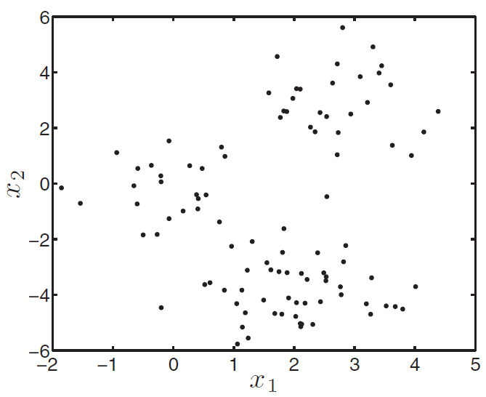
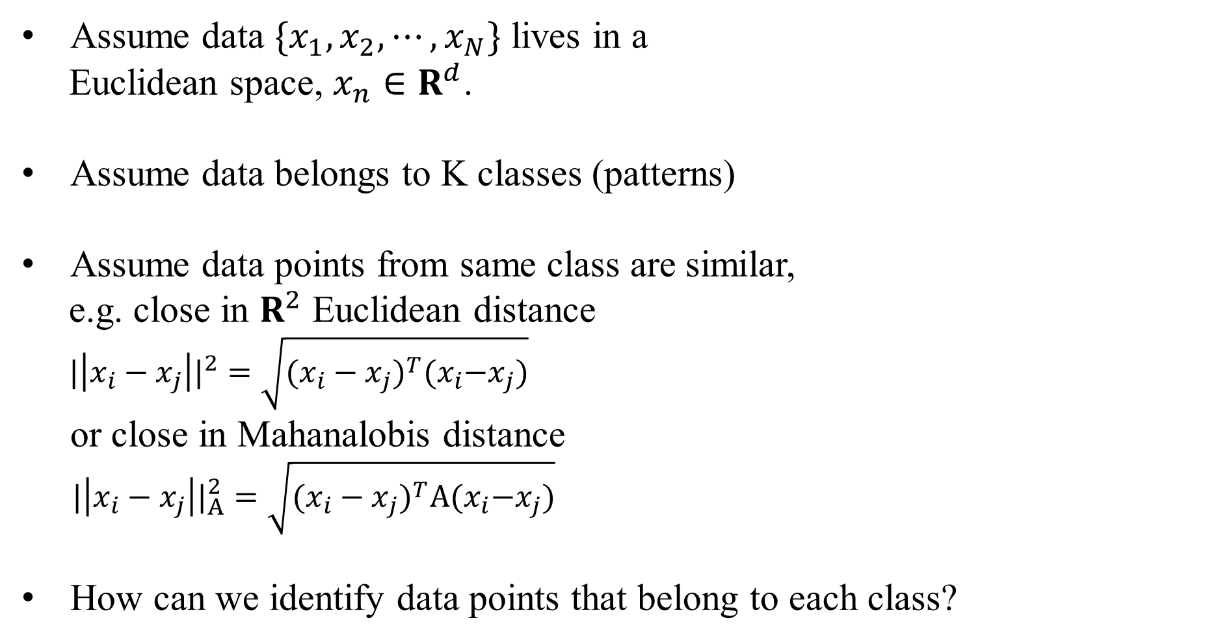
K-Means Clustering
Assume data $\{x_{1}, x_{2}, ⋯,x_{N}\}$ lives in a
Euclidean space, $x_{n}∈R^{d}$.
Assume data belongs to K classes (patterns)
Assume data points from same class are similar,
e.g. close in $R^{2}$ Euclidean distance
${|\left|x_{i}−x_{j}\right||}^{2}=\sqrt{{(x_{i}−x_{j})}^{T}{(x}_{i}−x_{j})}$
or close in Mahanalobis distance
${|\left|x_{i}−x_{j}\right||}_{A}^{2}=\sqrt{{(x_{i}−x_{j})}^{T}A{(x}_{i}−x_{j})}$
How can we identify data points that belong to each class?

Slide 3
K-Means: intuition
K-means assumes there are K clusters, and each point is close to its cluster center (the mean of points in the cluster).
If we knew the cluster assignment we could easily compute means.
If we knew the means we could easily compute cluster assignment.
Chicken and egg problem!
Very simple (and useful) heuristic - start randomly and alternate between the two!

Slide 4
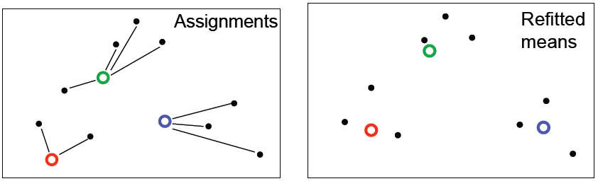
K-Means Clustering
Initialization: randomly initialize cluster centers
The algorithm iteratively alternates between two steps:
Assignment step: Assign each data point to the closest cluster
Refitting step: Move each cluster center to the center of gravity of the data assigned to it

Slide 5
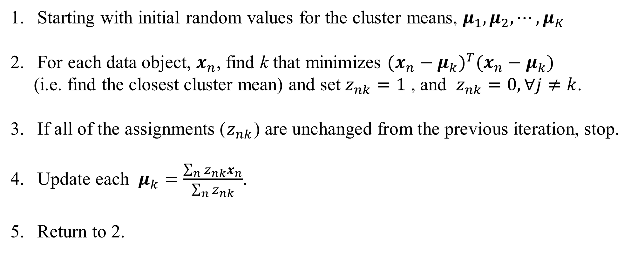
K-Means Algorithm
Starting with initial random values for the cluster means, $μ_{1}, μ_{2}, ⋯,μ_{K}$
For each data object, $x_{n}$, find k that minimizes ${(x_{n}−μ_{k})}^{T}(x_{n}−μ_{k})$
(i.e. find the closest cluster mean) and set $z_{nk}=1$ , and $z_{nk}=0, ∀j≠k$.
If all of the assignments ($z_{nk}$) are unchanged from the previous iteration, stop.
Update each $μ_{k}=\frac{\sum_{n}{z_{nk}x_{n}}}{\sum_{n}{z_{nk}}}$.
Return to 2.

Slide 6
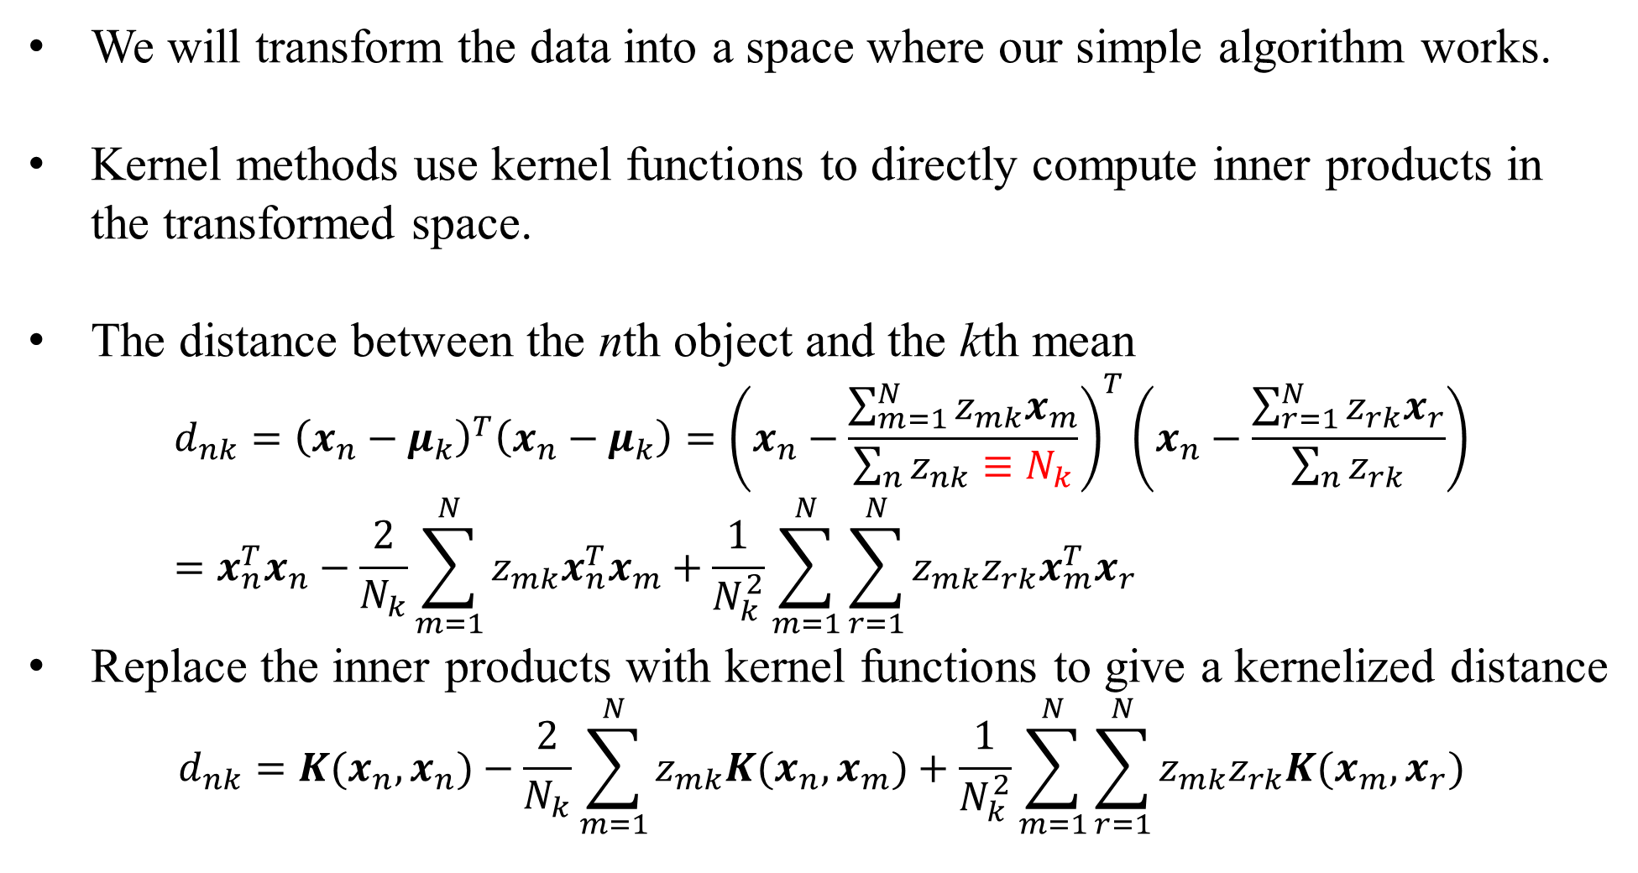
Kernelized K-means
We will transform the data into a space where our simple algorithm works.
Kernel methods use kernel functions to directly compute inner products in the transformed space.
The distance between the nth object and the kth mean
$${d_{nk}=\left(x_{n}−μ_{k}\right)}^{T}\left(x_{n}−μ_{k}\right)={\left(x_{n}−\frac{\sum_{m=1}^{N}{z_{mk}x_{m}}}{\sum_{n}{z_{nk}}≡N_{k}}\right)}^{T}\left(x_{n}−\frac{\sum_{r=1}^{N}{z_{rk}x_{r}}}{\sum_{n}{z_{rk}}}\right)=x_{n}^{T}x_{n}−\frac{2}{N_{k}}\sum_{m=1}^{N}{z_{mk}x_{n}^{T}x_{m}+\frac{1}{N_{k}^{2}}\sum_{m=1}^{N}{\sum_{r=1}^{N}{z_{mk}z_{rk}x_{m}^{T}x_{r}}}}$$
Replace the inner products with kernel functions to give a kernelized distance
$$d_{nk}=K(x_{n},x_{n})−\frac{2}{N_{k}}\sum_{m=1}^{N}{z_{mk}K(x_{n},x_{m})+\frac{1}{N_{k}^{2}}\sum_{m=1}^{N}{\sum_{r=1}^{N}{z_{mk}z_{rk}K(x_{m},x_{r})}}}$$

Slide 7
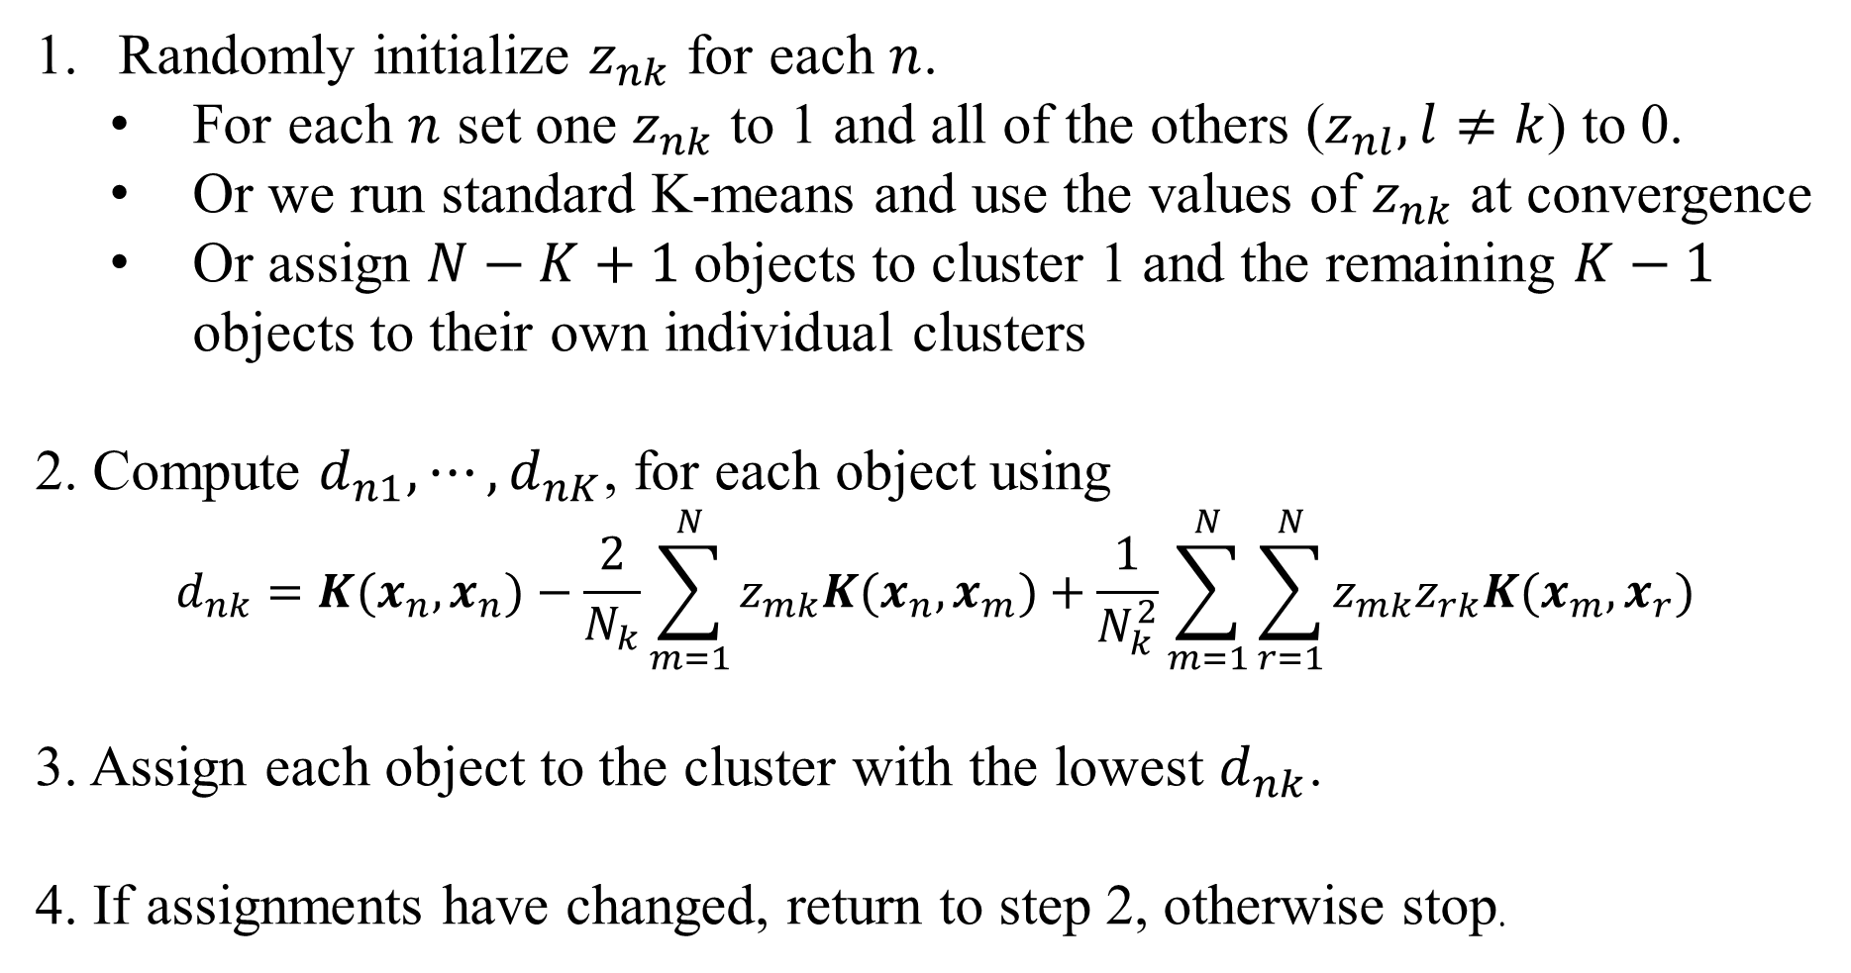
Kernelized K-Means Algorithm
Randomly initialize $z_{nk}$ for each $n$.
For each $n$ set one $z_{nk}$ to 1 and all of the others ($z_{nl}, l≠k$) to 0.
Or we run standard K-means and use the values of $z_{nk}$ at convergence
Or assign $N−K+1$objects to cluster 1 and the remaining $K−1$ objects to their own individual clusters
2. Compute $d_{n1}, ⋯,d_{nK}$, for each object using
$$d_{nk}=K(x_{n},x_{n})−\frac{2}{N_{k}}\sum_{m=1}^{N}{z_{mk}K(x_{n},x_{m})+\frac{1}{N_{k}^{2}}\sum_{m=1}^{N}{\sum_{r=1}^{N}{z_{mk}z_{rk}K(x_{m},x_{r})}}}$$
3. Assign each object to the cluster with the lowest $d_{nk}$.
4. If assignments have changed, return to step 2, otherwise stop.

Slide 8
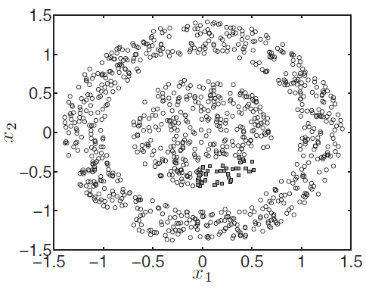
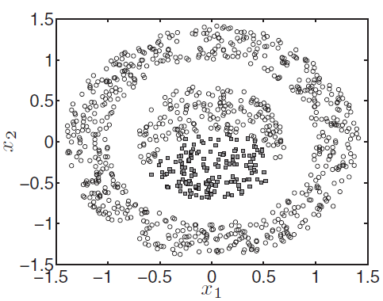
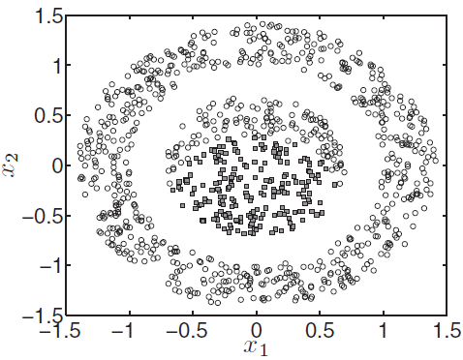
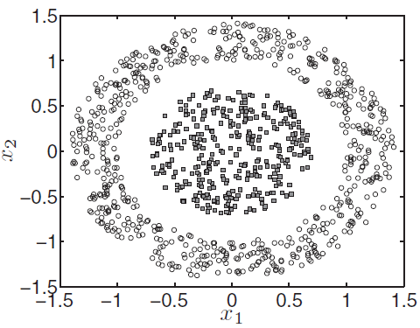
after 1 iteration
after 5 iterations
after 10 iterations
At convergence,
30 iterations

Slide 9
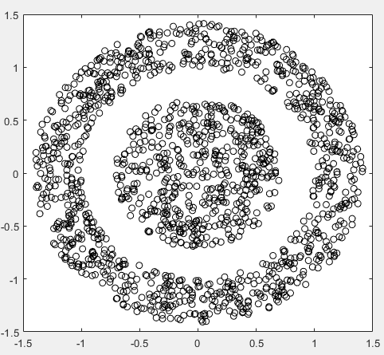
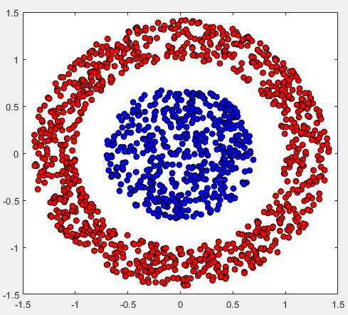
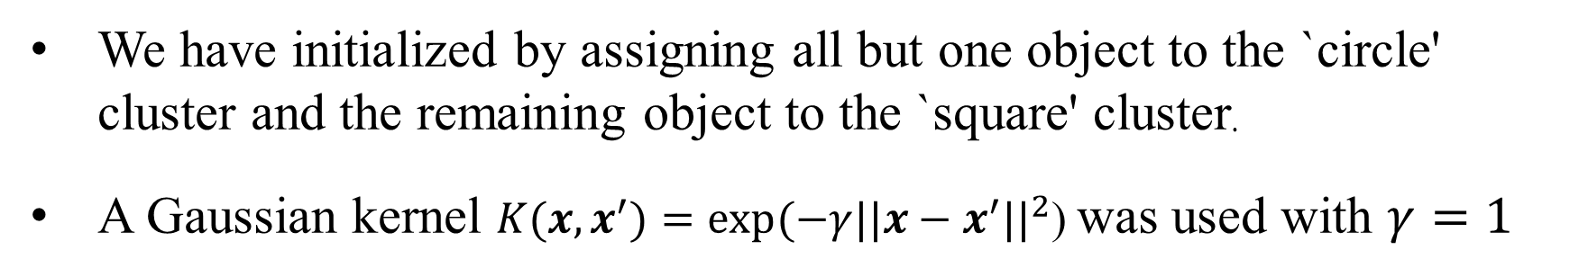
Result of MATLAB script: kernelkmeans.m
We have initialized by assigning all but one object to the `circle' cluster and the remaining object to the `square' cluster.
A Gaussian kernel ${K(x,x}^{′})=exp(−γ{{||x−x}^{′}||}^{2}$) was used with $γ=1$

Slide 10
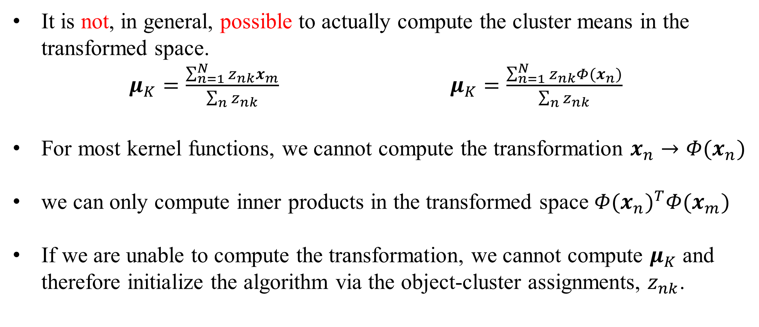
Remarks
It is not, in general, possible to actually compute the cluster means in the transformed space.
$μ_{K}=\frac{\sum_{n=1}^{N}{z_{nk}x_{m}}}{\sum_{n}{z_{nk}}}$ $μ_{K}=\frac{\sum_{n=1}^{N}{z_{nk}Φ(x_{n})}}{\sum_{n}{z_{nk}}}$
For most kernel functions, we cannot compute the transformation $x_{n}→Φ(x_{n})$
we can only compute inner products in the transformed space ${Φ(x_{n})}^{T}Φ(x_{m})$
If we are unable to compute the transformation, we cannot compute $μ_{K}$ and therefore initialize the algorithm via the object-cluster assignments, $z_{nk}$.

Slide 11
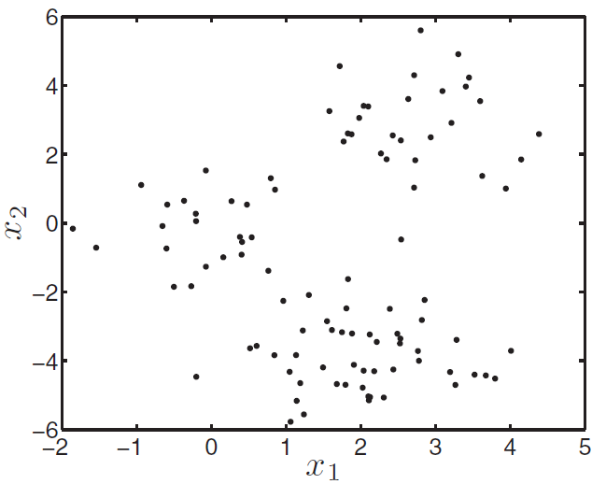
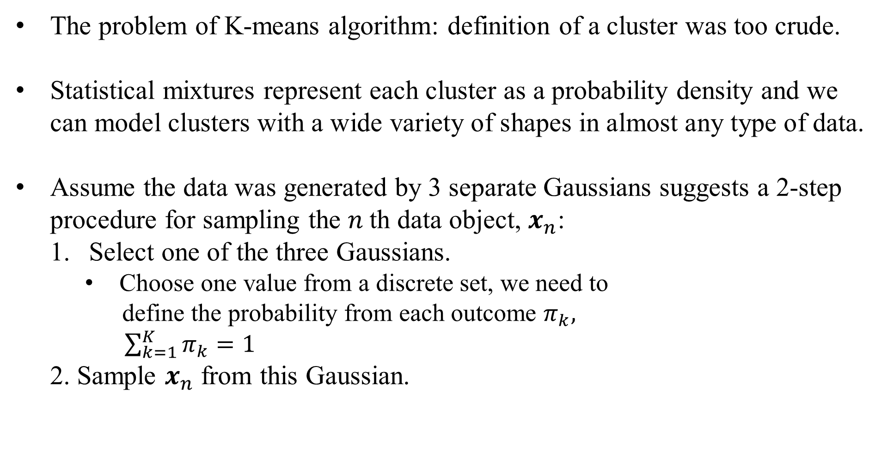
Mixture Models and A Generative Process
The problem of K-means algorithm: definition of a cluster was too crude.
Statistical mixtures represent each cluster as a probability density and we can model clusters with a wide variety of shapes in almost any type of data.
Assume the data was generated by 3 separate Gaussians suggests a 2-step procedure for sampling the $n$th data object, $x_{n}$:
Select one of the three Gaussians.
Choose one value from a discrete set, we need to
define the probability from each outcome $π_{k},$
$\sum_{k=1}^{K}{π_{k}}=1$
2. Sample $x_{n}$ from this Gaussian.

Slide 12
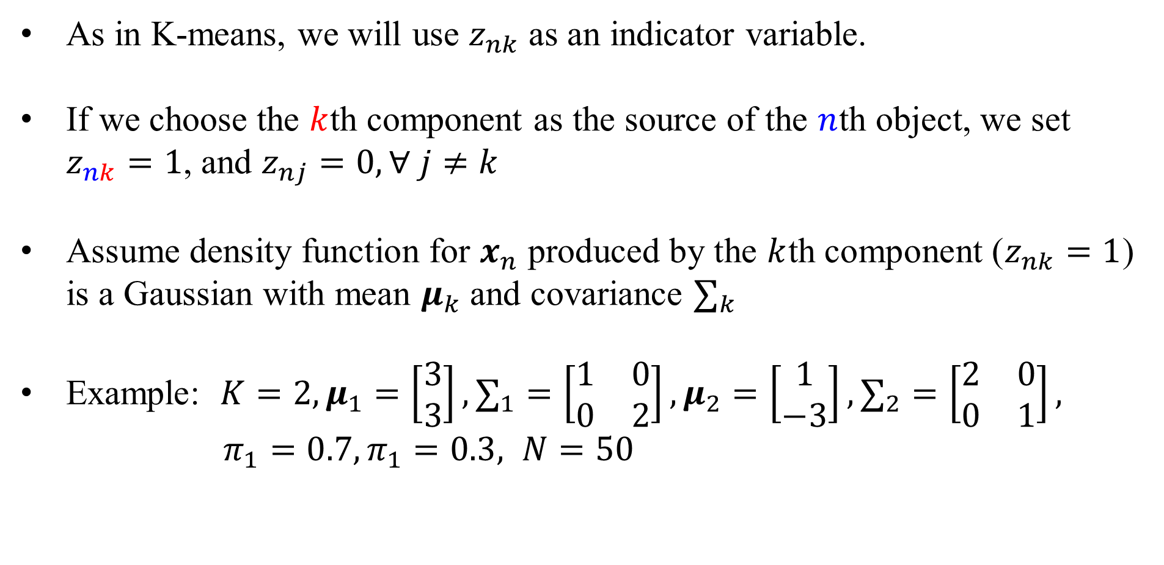
Mixture Models and A Generative Process
As in K-means, we will use $z_{nk}$ as an indicator variable.
If we choose the $k$th component as the source of the $n$th object, we set $z_{nk}=1$, and $z_{nj}=0, ∀ j≠k$
Assume density function for $x_{n}$ produced by the $k$th component ($z_{nk}=1$) is a Gaussian with mean $μ_{k}$ and covariance $∑_{k}$
Example: $K=2, μ_{1}=\left[\begin{matrix}3 \\ 3\end{matrix}\right],∑_{1}=\left[\begin{matrix}1 & 0 \\ 0 & 2\end{matrix}\right], μ_{2}=\left[\begin{matrix}1 \\ −3\end{matrix}\right], ∑_{2}=\left[\begin{matrix}2 & 0 \\ 0 & 1\end{matrix}\right],$
$π_{1}=0.7,π_{1}=0.3, N=50$

Slide 13
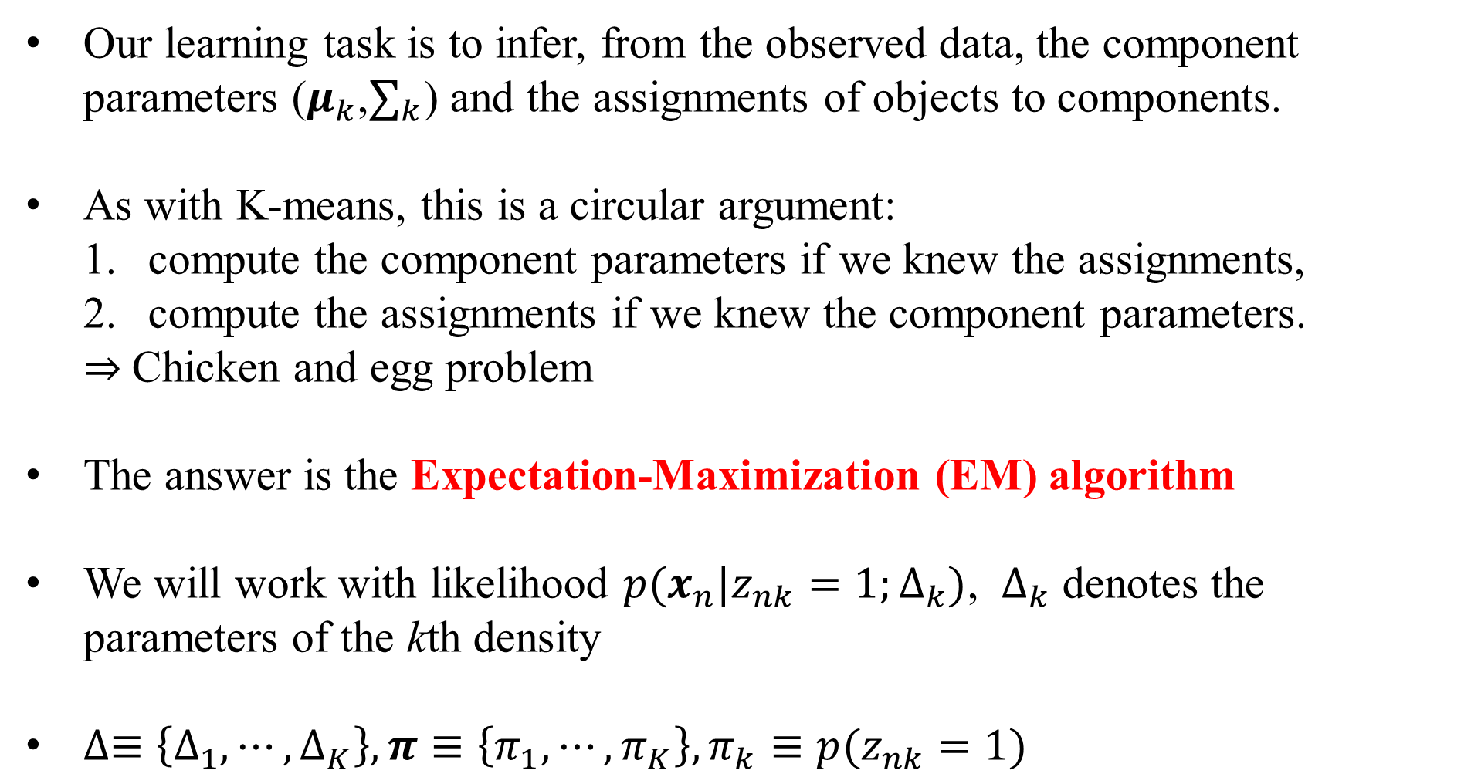
Mixture Model Likelihood
Our learning task is to infer, from the observed data, the component parameters ($μ_{k}$,$∑_{k}$) and the assignments of objects to components.
As with K-means, this is a circular argument:
compute the component parameters if we knew the assignments,
compute the assignments if we knew the component parameters.
⇒ Chicken and egg problem
The answer is the Expectation-Maximization (EM) algorithm
We will work with likelihood ${p(x_{n}|z}_{nk}=1;∆_{k})$, $∆_{k}$ denotes the parameters of the kth density
$∆≡\left\{∆_{1}, ⋯,∆_{K}\right\}, π≡\left\{π_{1}, ⋯,π_{K}\right\}, π_{k}≡{p(z}_{nk}=1)$

Slide 14
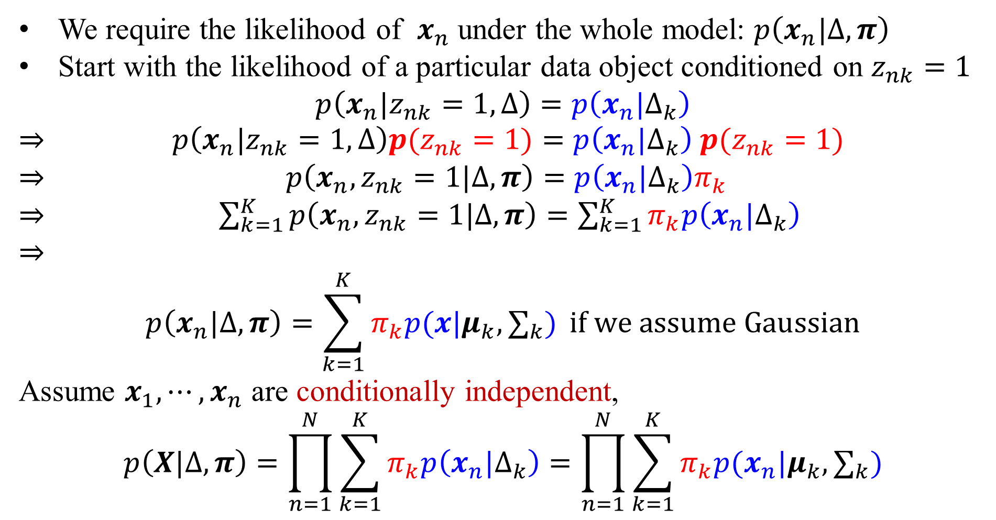
We Start from Likelihood as Usual
We require the likelihood of $x_{n}$ under the whole model: $p\left(x_{n}|∆, π\right)$
Start with the likelihood of a particular data object conditioned on $z_{nk}=1$
$$p\left(x_{n}|z_{nk}=1,∆\right)=p\left(x_{n}|∆_{k}\right)$$
⇒ $p\left(x_{n}|z_{nk}=1,∆\right)p(z_{nk}=1)=p\left(x_{n}|∆_{k}\right)$ $p(z_{nk}=1)$
⇒ $p\left(x_{n},z_{nk}=1|∆, π\right)=p\left(x_{n}|∆_{k}\right)π_{k}$
⇒ $\sum_{k=1}^{K}{p\left(x_{n},z_{nk}=1|∆, π\right)}=\sum_{k=1}^{K}{π_{k}p\left(x_{n}|∆_{k}\right)}$
⇒
$$p\left(x_{n}|∆, π\right)=\sum_{k=1}^{K}{π_{k}p(x|μ_{k}, ∑_{k})} if we assume Gaussian$$
Assume $x_{1}, ⋯,x_{n}$ are conditionally independent,
$$p\left(X|∆, π\right)=\prod_{n=1}^{N}{\sum_{k=1}^{K}{π_{k}p\left(x_{n}|∆_{k}\right)}}=\prod_{n=1}^{N}{\sum_{k=1}^{K}{π_{k}p(x_{n}|μ_{k}, ∑_{k})}}$$

Slide 15
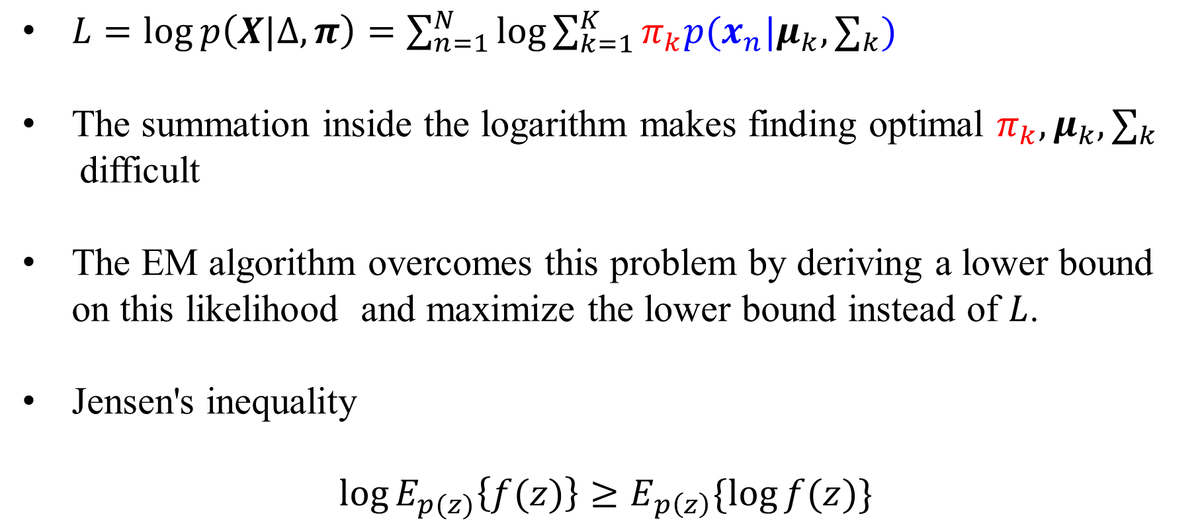
Using the EM Algorithm to Maximize Likelihood
$L=\log{p\left(X|∆, π\right)}=\sum_{n=1}^{N}{\log{\sum_{k=1}^{K}{π_{k}p(x_{n}|μ_{k}, ∑_{k})}}}$
The summation inside the logarithm makes finding optimal $π_{k},μ_{k}, ∑_{k}$
difficult
The EM algorithm overcomes this problem by deriving a lower bound on this likelihood and maximize the lower bound instead of $L$.
Jensen's inequality
$$\log{E_{p(z)}\left\{f(z)\right\}}≥E_{p\left(z\right)}\{\log{f(z)}\}$$

Slide 16
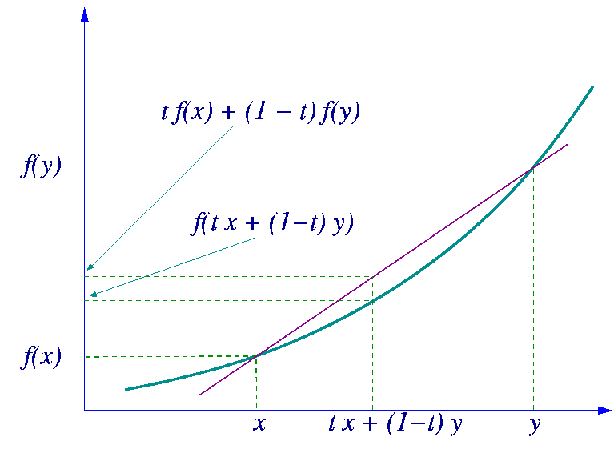
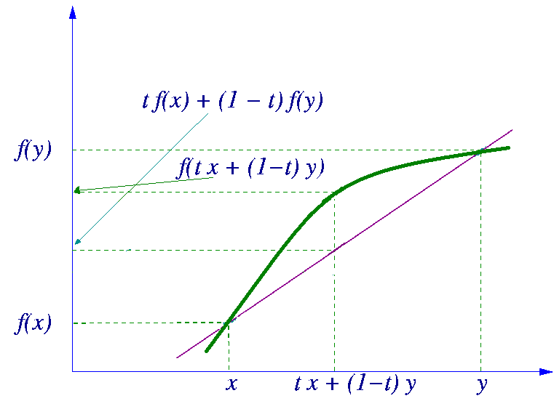
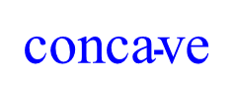
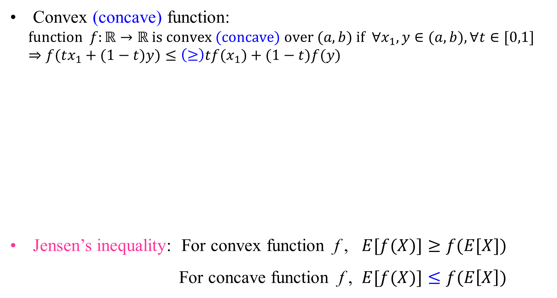
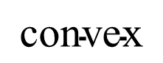
Jensen’s inequality
Convex (concave) function:
$$\text{function} f:ℝ→ℝ \text{is} \text{convex} \text{(}\text{concave}\text{) }\text{over} (a,b) \text{if} ∀x_{1},y∈(a,b),∀t∈[0,1] \\ ⇒f(tx_{1}+(1−t)y)≤\left(≥\right)tf(x_{1})+(1−t)f(y)$$
Jensen’s inequality: For convex function f , $E[f(X)]≥f(E[X])$
For concave function f , $E[f(X)]≤f(E\left[X\right])$
$$\text{convex}$$
$$\text{con}\text{cave}$$

Slide 17
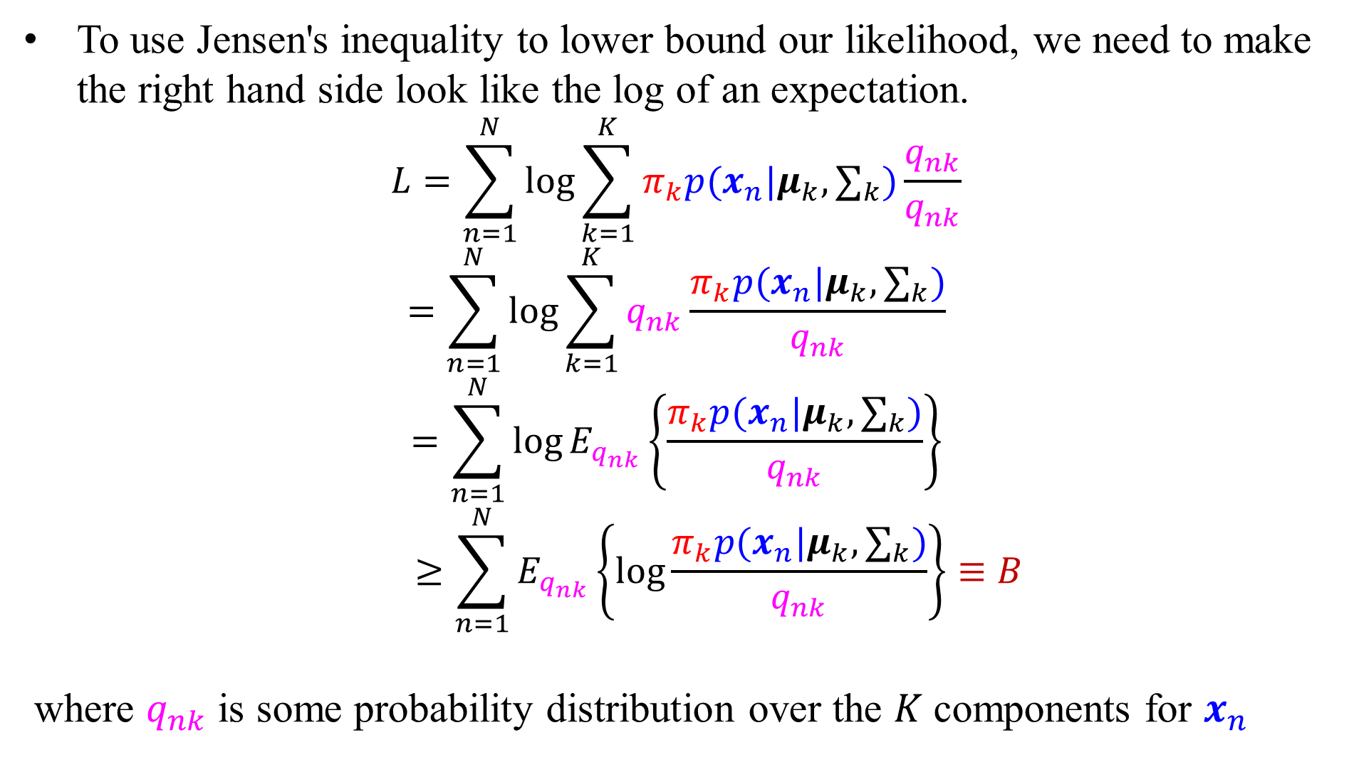
Lower Bound of the Log-Likelihood
To use Jensen's inequality to lower bound our likelihood, we need to make the right hand side look like the log of an expectation.
$$L=\sum_{n=1}^{N}{\log{\sum_{k=1}^{K}{π_{k}p(x_{n}|μ_{k}, ∑_{k})}}}\frac{q_{nk}}{q_{nk}}$$
$$=\sum_{n=1}^{N}{\log{\sum_{k=1}^{K}{q_{nk}}}}\frac{π_{k}p(x_{n}|μ_{k}, ∑_{k})}{q_{nk}}$$
$$=\sum_{n=1}^{N}{\log{E_{q_{nk}}\left\{\frac{π_{k}p(x_{n}|μ_{k}, ∑_{k})}{q_{nk}}\right\}}}$$
$$≥\sum_{n=1}^{N}{E_{q_{nk}}\left\{\log{\frac{π_{k}p(x_{n}|μ_{k}, ∑_{k})}{q_{nk}}}\right\}}≡B$$
where $q_{nk}$ is some probability distribution over the $K$ components for $x_{n}$

Slide 18
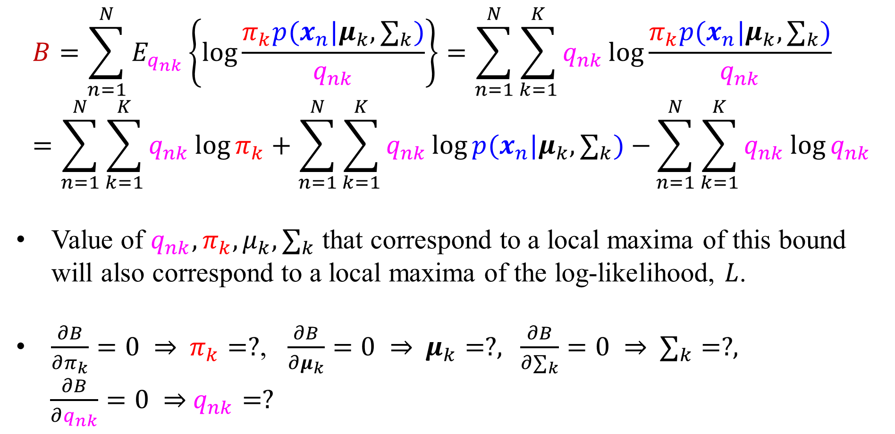
Lower Bound of the Log-Likelihood
$$B=\sum_{n=1}^{N}{E_{q_{nk}}\left\{\log{\frac{π_{k}p(x_{n}|μ_{k}, ∑_{k})}{q_{nk}}}\right\}}=\sum_{n=1}^{N}{\sum_{k=1}^{K}{q_{nk}\log{\frac{π_{k}p(x_{n}|μ_{k}, ∑_{k})}{q_{nk}}}}}=\sum_{n=1}^{N}{\sum_{k=1}^{K}{q_{nk}\log{π_{k}}}}+\sum_{n=1}^{N}{\sum_{k=1}^{K}{q_{nk}\log{p(x_{n}|μ_{k}, ∑_{k})}}−}\sum_{n=1}^{N}{\sum_{k=1}^{K}{q_{nk}\log{q_{nk}}}}$$
Value of $q_{nk},π_{k},μ_{k}, ∑_{k}$ that correspond to a local maxima of this bound will also correspond to a local maxima of the log-likelihood, $L$.
$\frac{∂B}{∂π_{k}}=0$ ⇒ $π_{k}=?$, $\frac{∂B}{∂μ_{k}}=0$ ⇒ $μ_{k}=?$, $\frac{∂B}{∂∑_{k}}=0$ ⇒ $∑_{k}=?$,
$\frac{∂B}{∂q_{nk}}=0$ ⇒ $q_{nk}=?$

Slide 19
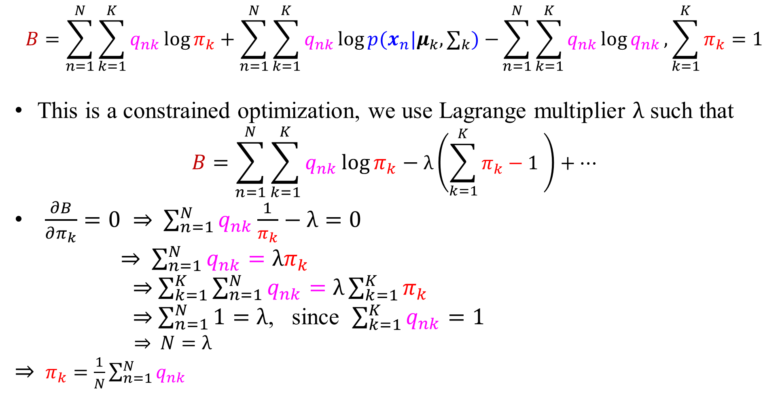
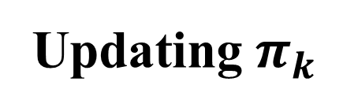
Updating $π_{k}$
$$B=\sum_{n=1}^{N}{\sum_{k=1}^{K}{q_{nk}\log{π_{k}}}}+\sum_{n=1}^{N}{\sum_{k=1}^{K}{q_{nk}\log{p(x_{n}|μ_{k}, ∑_{k})}}−}\sum_{n=1}^{N}{\sum_{k=1}^{K}{q_{nk}\log{q_{nk}}}},\sum_{k=1}^{K}{π_{k}}=1$$
This is a constrained optimization, we use Lagrange multiplier $λ$ such that
$$B=\sum_{n=1}^{N}{\sum_{k=1}^{K}{q_{nk}\log{π_{k}}}}−λ\left(\sum_{k=1}^{K}{π_{k}}−1 \right)+⋯$$
$\frac{∂B}{∂π_{k}}=0$ ⇒ $\sum_{n=1}^{N}{q_{nk}}\frac{1}{π_{k}}−λ=0$
⇒ $\sum_{n=1}^{N}{q_{nk}}=λπ_{k}$
⇒ $\sum_{k=1}^{K}{\sum_{n=1}^{N}{q_{nk}}}=λ\sum_{k=1}^{K}{π_{k}}$
⇒ $\sum_{n=1}^{N}{1}=λ$, since $\sum_{k=1}^{K}{q_{nk}}=1$
⇒ $N=λ$
⇒ $π_{k}=\frac{1}{N}\sum_{n=1}^{N}{q_{nk}}$

Slide 20
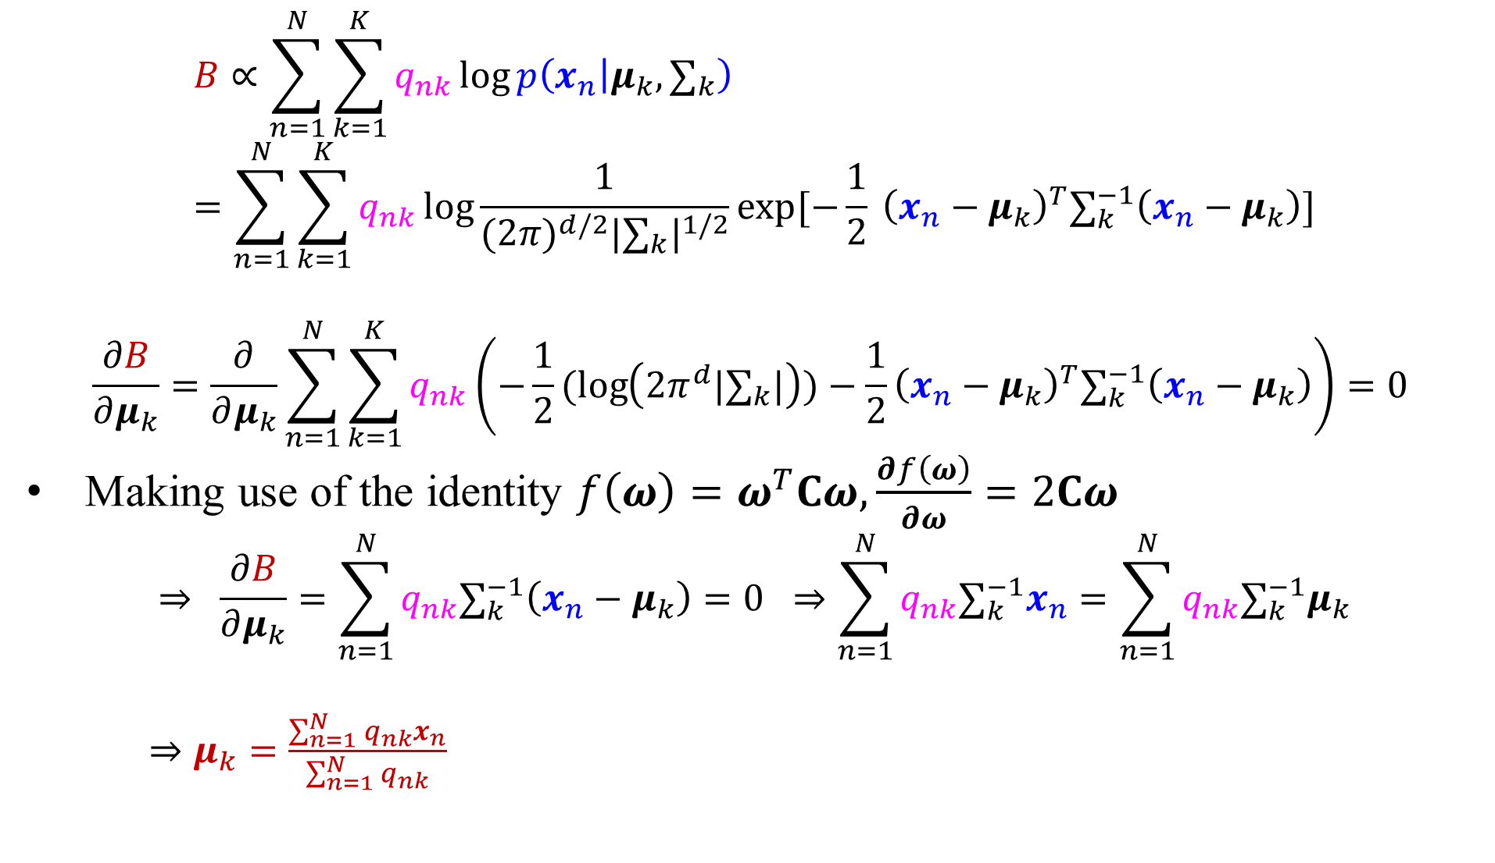
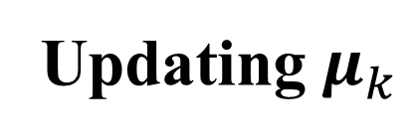
Updating $μ_{k}$
$$B∝\sum_{n=1}^{N}{\sum_{k=1}^{K}{q_{nk}\log{p\left(x_{n} | μ_{k}, ∑_{k}\right)}}}=\sum_{n=1}^{N}{\sum_{k=1}^{K}{q_{nk}\log{\frac{1}{{(2π)}^{d/2}{|∑_{k}|}^{1/2}}exp[−\frac{1}{2} {\left(x_{n}−μ_{k}\right)}^{T}∑_{k}^{−1}\left(x_{n}−μ_{k}\right)]}}}$$
$$\frac{∂B}{∂μ_{k}}=\frac{∂}{∂μ_{k}}\sum_{n=1}^{N}{\sum_{k=1}^{K}{q_{nk}}}\left(−\frac{1}{2}(log\left({2π}^{d}|∑_{k}|\right))−\frac{1}{2}{\left(x_{n}−μ_{k}\right)}^{T}∑_{k}^{−1}\left(x_{n}−μ_{k}\right)\right)=0$$
Making use of the identity $f\left(ω\right)=ω^{T}Cω, \frac{∂f\left(ω\right)}{∂ω}=2Cω$
$$⇒ \frac{∂B}{∂μ_{k}}=\sum_{n=1}^{N}{q_{nk}∑_{k}^{−1}\left(x_{n}−μ_{k}\right)}=0 ⇒\sum_{n=1}^{N}{q_{nk}∑_{k}^{−1}x_{n}}=\sum_{n=1}^{N}{q_{nk}∑_{k}^{−1}μ_{k}}$$
$⇒μ_{k}=\frac{\sum_{n=1}^{N}{q_{nk}}x_{n}}{\sum_{n=1}^{N}{q_{nk}}}$

Slide 21
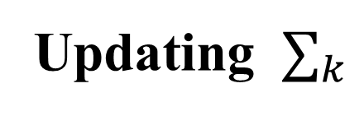
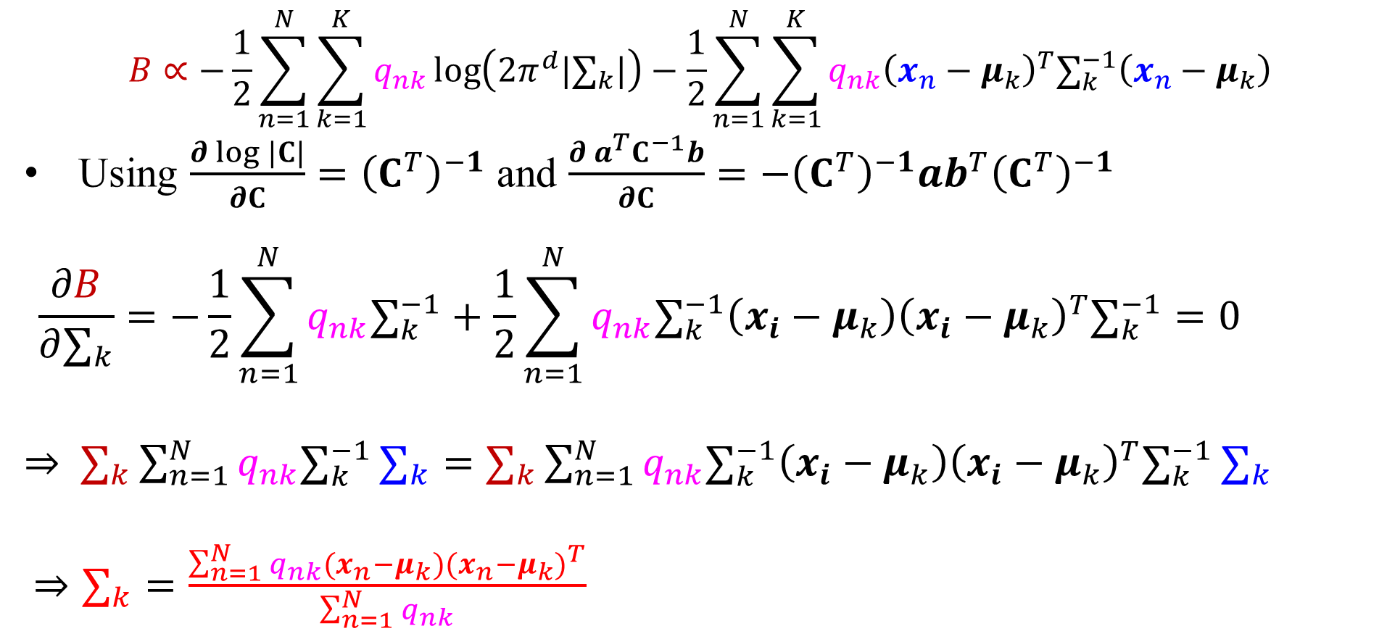
Updating $∑_{k}$
$$B∝−\frac{1}{2}\sum_{n=1}^{N}{\sum_{k=1}^{K}{q_{nk}\log\left({2π}^{d}|∑_{k}|\right)}}−\frac{1}{2}\sum_{n=1}^{N}{\sum_{k=1}^{K}{{q_{nk}\left(x_{n}−μ_{k}\right)}^{T}∑_{k}^{−1}\left(x_{n}−μ_{k}\right)}}$$
Using $\frac{∂ log |C|}{∂C}={\left(C^{T}\right)}^{−1}$ and $\frac{∂ a^{T}C^{−1}b}{∂C}=−{\left(C^{T}\right)}^{−1}ab^{T}{\left(C^{T}\right)}^{−1}$
$$\frac{∂B}{∂∑_{k}}=−\frac{1}{2}\sum_{n=1}^{N}{q_{nk}∑_{k}^{−1}}+\frac{1}{2}\sum_{n=1}^{N}{{q_{nk}∑_{k}^{−1}\left(x_{i}−μ_{k}\right)\left(x_{i}−μ_{k}\right)}^{T}∑_{k}^{−1}}=0$$
$⇒$ $∑_{k}\sum_{n=1}^{N}{q_{nk}∑_{k}^{−1}}∑_{k}=∑_{k}\sum_{n=1}^{N}{{q_{nk}∑_{k}^{−1}\left(x_{i}−μ_{k}\right)\left(x_{i}−μ_{k}\right)}^{T}∑_{k}^{−1}}∑_{k}$
$⇒∑_{k}=\frac{\sum_{n=1}^{N}{q_{nk}}{(x_{n}−μ_{k})(x_{n}−μ_{k})}^{T}}{\sum_{n=1}^{N}{q_{nk}}}$

Slide 22
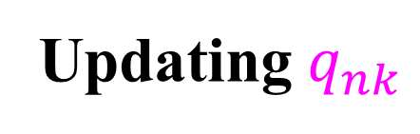
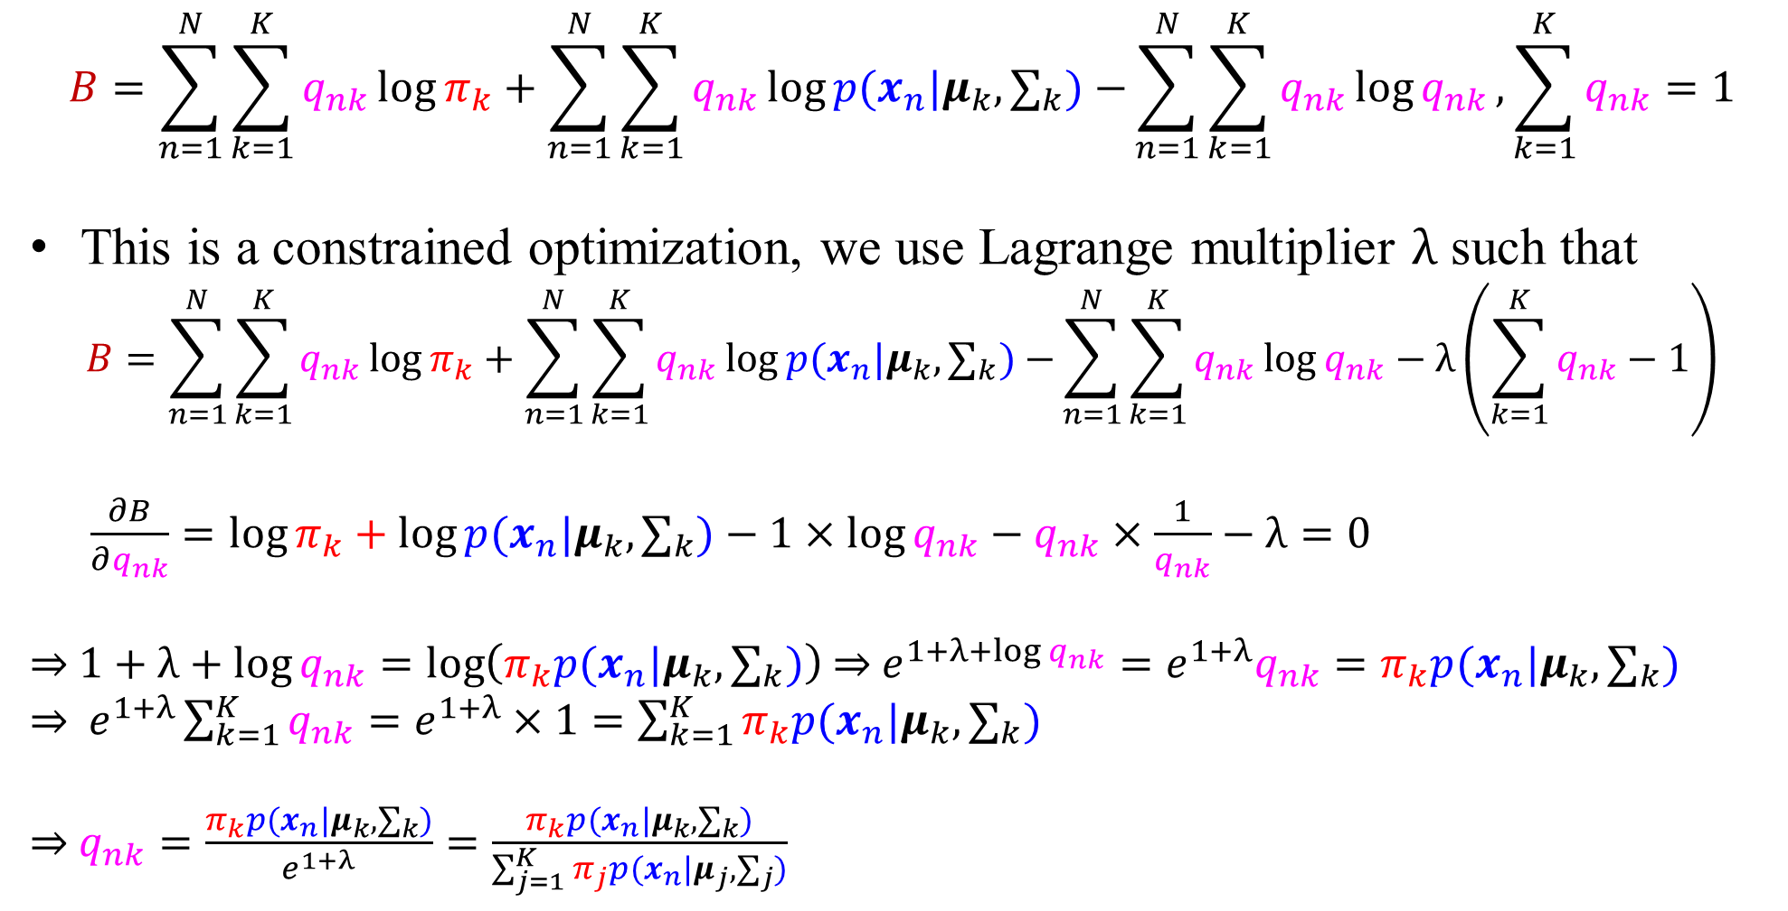
Updating $q_{nk}$
$$B=\sum_{n=1}^{N}{\sum_{k=1}^{K}{q_{nk}\log{π_{k}}}}+\sum_{n=1}^{N}{\sum_{k=1}^{K}{q_{nk}\log{p(x_{n}|μ_{k}, ∑_{k})}}−}\sum_{n=1}^{N}{\sum_{k=1}^{K}{q_{nk}\log{q_{nk}}}},\sum_{k=1}^{K}{q_{nk}}=1$$
This is a constrained optimization, we use Lagrange multiplier $λ$ such that
$$B=\sum_{n=1}^{N}{\sum_{k=1}^{K}{q_{nk}\log{π_{k}}}}+\sum_{n=1}^{N}{\sum_{k=1}^{K}{q_{nk}\log{p(x_{n}|μ_{k}, ∑_{k})}}−}\sum_{n=1}^{N}{\sum_{k=1}^{K}{q_{nk}\log{q_{nk}}}}−λ\left(\sum_{k=1}^{K}{q_{nk}}−1\right)$$
$\frac{∂B}{∂q_{nk}}=\log{π_{k}}+\log{p(x_{n}|μ_{k}, ∑_{k})}−1×\log{q_{nk}}−q_{nk}×\frac{1}{q_{nk}}−λ=0$
⇒ $1+λ+\log{q_{nk}}=\log\left(π_{k}p(x_{n}|μ_{k}, ∑_{k})\right)$ ⇒ $e^{1+λ+\log{q_{nk}}}=e^{1+λ}q_{nk}=π_{k}p(x_{n}|μ_{k}, ∑_{k})$
⇒ $e^{1+λ}\sum_{k=1}^{K}{q_{nk}}=e^{1+λ}×1=\sum_{k=1}^{K}{π_{k}p(x_{n}|μ_{k}, ∑_{k})}$
⇒ $q_{nk}=\frac{π_{k}p(x_{n}|μ_{k}, ∑_{k})}{e^{1+λ}}=\frac{π_{k}p(x_{n}|μ_{k}, ∑_{k})}{\sum_{j=1}^{K}{π_{j}p(x_{n}|μ_{j}, ∑_{j})}}$

Slide 23
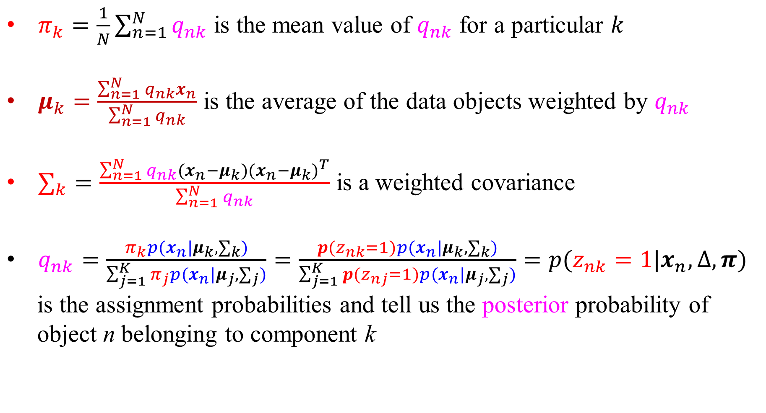
Some Intuition
$π_{k}=\frac{1}{N}\sum_{n=1}^{N}{q_{nk}}$ is the mean value of $q_{nk}$ for a particular $k$
$μ_{k}=\frac{\sum_{n=1}^{N}{q_{nk}}x_{n}}{\sum_{n=1}^{N}{q_{nk}}}$ is the average of the data objects weighted by $q_{nk}$
$∑_{k}=\frac{\sum_{n=1}^{N}{q_{nk}}{(x_{n}−μ_{k})(x_{n}−μ_{k})}^{T}}{\sum_{n=1}^{N}{q_{nk}}}$ is a weighted covariance
$q_{nk}=\frac{π_{k}p(x_{n}|μ_{k}, ∑_{k})}{\sum_{j=1}^{K}{π_{j}p(x_{n}|μ_{j}, ∑_{j})}}=\frac{p(z_{nk}=1)p(x_{n}|μ_{k}, ∑_{k})}{\sum_{j=1}^{K}{p(z_{nj}=1)p(x_{n}|μ_{j}, ∑_{j})}}=p(z_{nk}=1|x_{n},∆, π)$
is the assignment probabilities and tell us the posterior probability of
object n belonging to component k

Slide 24
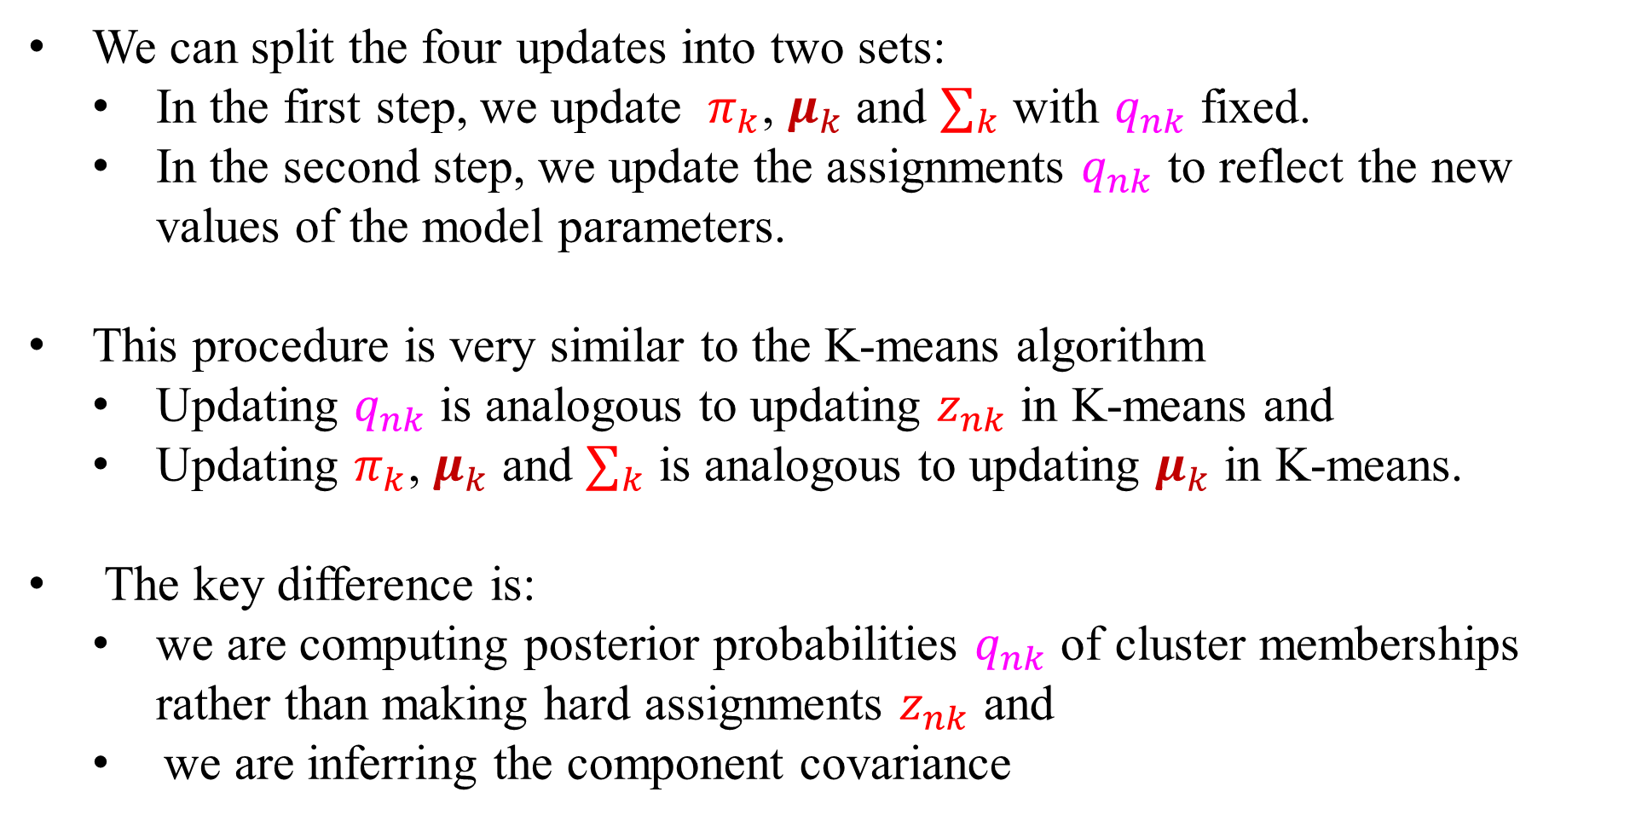
EM versus K-means
We can split the four updates into two sets:
In the first step, we update $π_{k}$, $μ_{k}$ and $∑_{k}$ with $q_{nk}$ fixed.
In the second step, we update the assignments $q_{nk}$ to reflect the new values of the model parameters.
This procedure is very similar to the K-means algorithm
Updating $q_{nk}$ is analogous to updating $z_{nk}$ in K-means and
Updating $π_{k}$, $μ_{k}$ and $∑_{k}$ is analogous to updating $μ_{k}$ in K-means.
The key difference is:
we are computing posterior probabilities $q_{nk}$ of cluster memberships rather than making hard assignments $z_{nk}$ and
we are inferring the component covariance

Slide 25
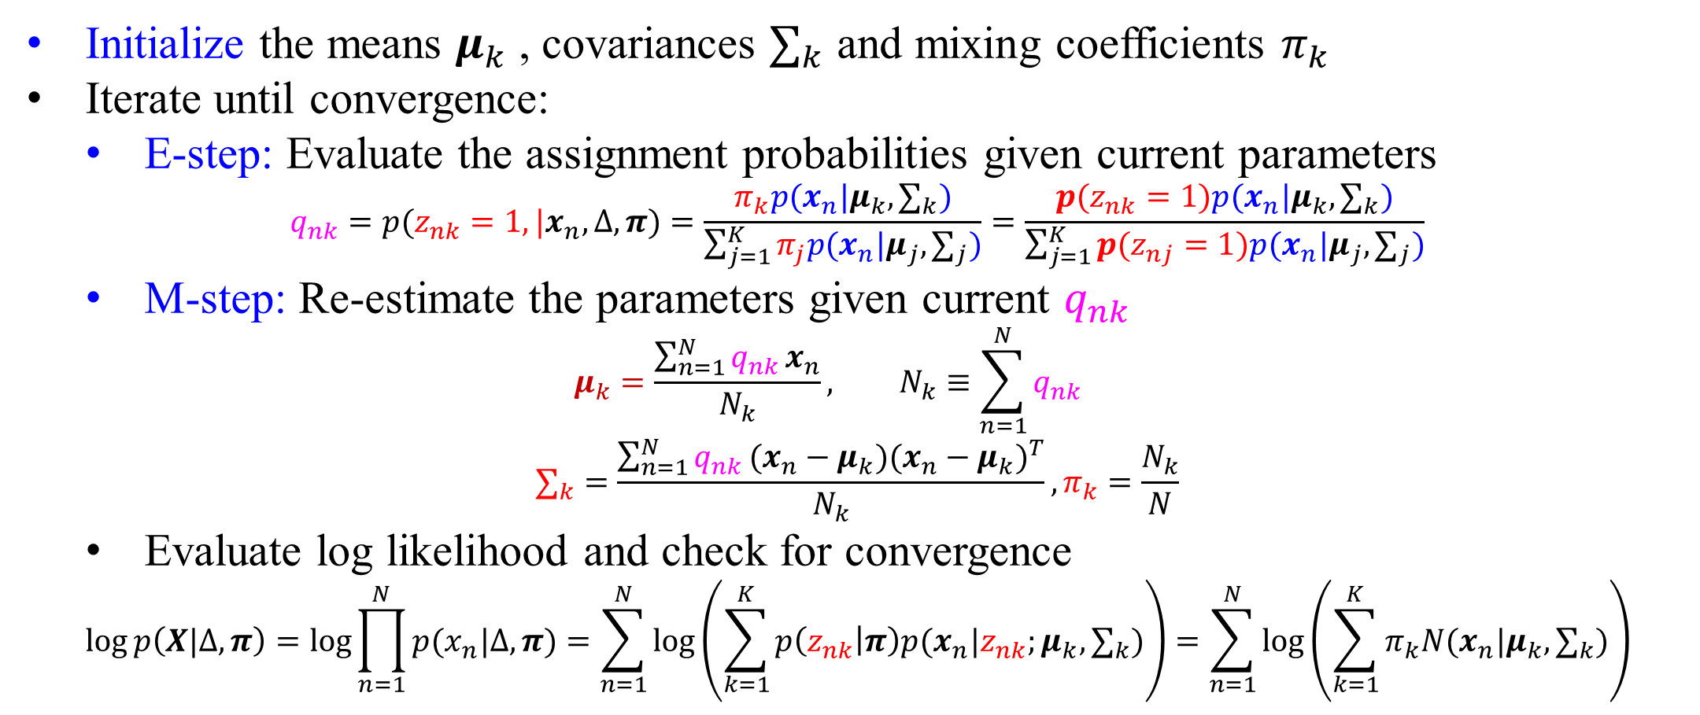
EM Algorithm for Gaussian Mixture Model (GMM)
Initialize the means $μ_{k}$ , covariances $∑_{k}$ and mixing coefficients $π_{k}$
Iterate until convergence:
E-step: Evaluate the assignment probabilities given current parameters
$$q_{nk}=p(z_{nk}=1, |x_{n},∆, π)=\frac{π_{k}p(x_{n}|μ_{k}, ∑_{k})}{\sum_{j=1}^{K}{π_{j}p(x_{n}|μ_{j}, ∑_{j})}}=\frac{p(z_{nk}=1)p(x_{n}|μ_{k}, ∑_{k})}{\sum_{j=1}^{K}{p(z_{nj}=1)p(x_{n}|μ_{j}, ∑_{j})}}$$
M-step: Re-estimate the parameters given current $q_{nk}$
$$μ_{k}=\frac{\sum_{n=1}^{N}{q_{nk}}x_{n}}{N_{k}}, N_{k}≡\sum_{n=1}^{N}{q_{nk}}$$
$$∑_{k}=\frac{\sum_{n=1}^{N}{q_{nk}}{(x_{n}−μ_{k})(x_{n}−μ_{k})}^{T}}{N_{k}},π_{k}=\frac{N_{k}}{N}$$
Evaluate log likelihood and check for convergence
$$\log{p\left(X|∆, π\right)}=\log{\prod_{n=1}^{N}{p(x_{n}|∆, π)}}=\sum_{n=1}^{N}{\log\left(\sum_{k=1}^{K}{p\left(z_{nk} | π\right)p(x_{n}|z_{nk};μ_{k}, ∑_{k})}\right)}=\sum_{n=1}^{N}{\log\left(\sum_{k=1}^{K}{π_{k}N(x_{n}|μ_{k},∑_{k})}\right)}$$

Slide 26
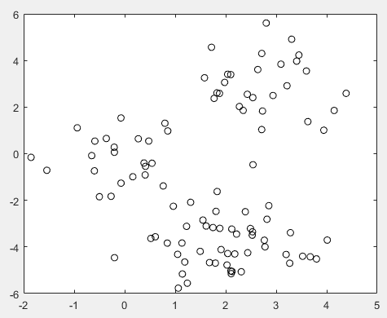
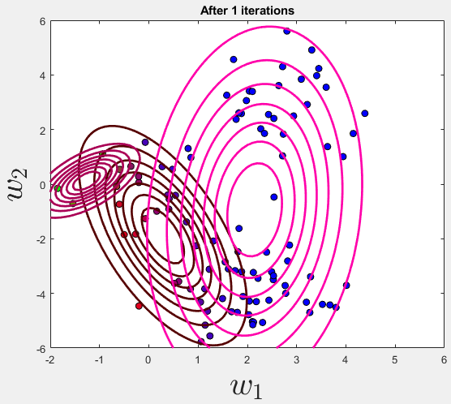
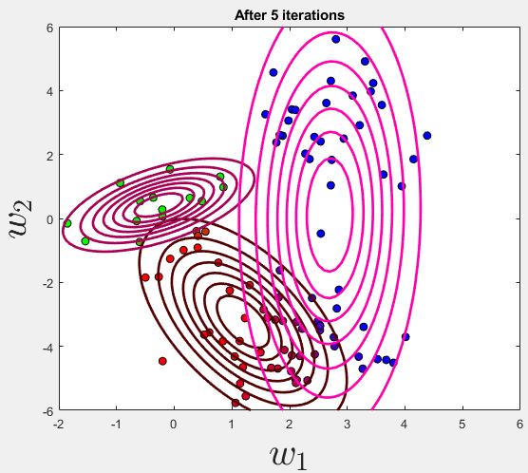
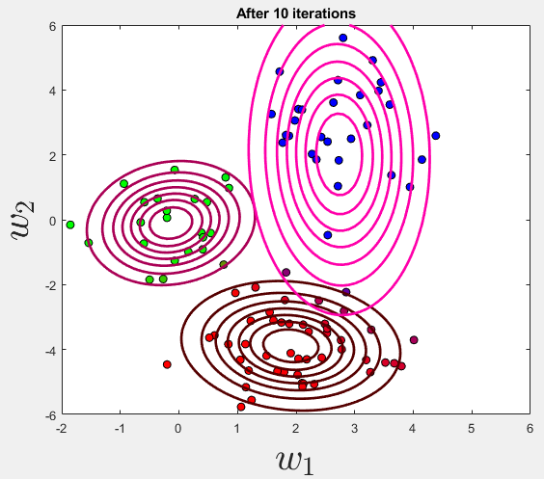
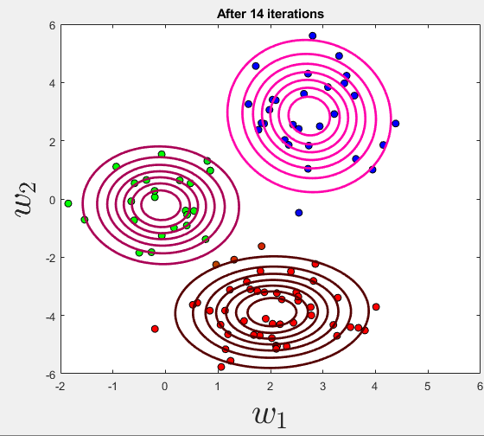
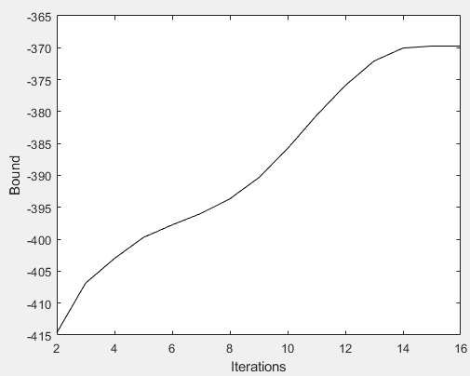
bound B

Slide 27
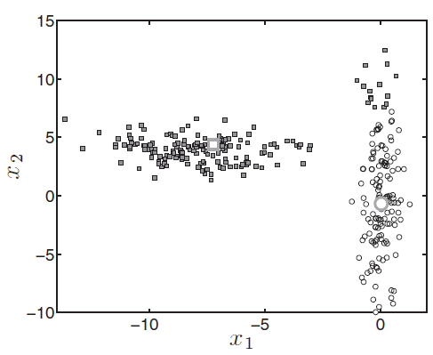
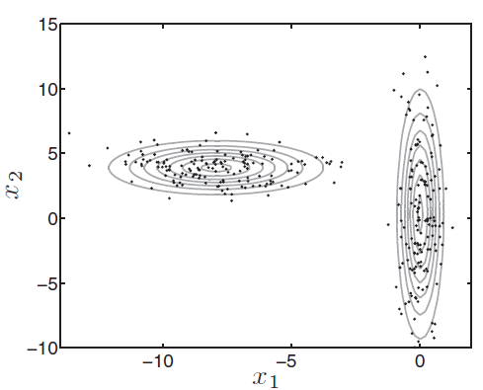
The Data K-means Failed and the Mixture Model Successes
Left: Synthetic cluster data on which K-means failed (objects labeled according to the K-means solution)
Right: The converged mixture model with K = 2 Gaussian components.

Slide 28
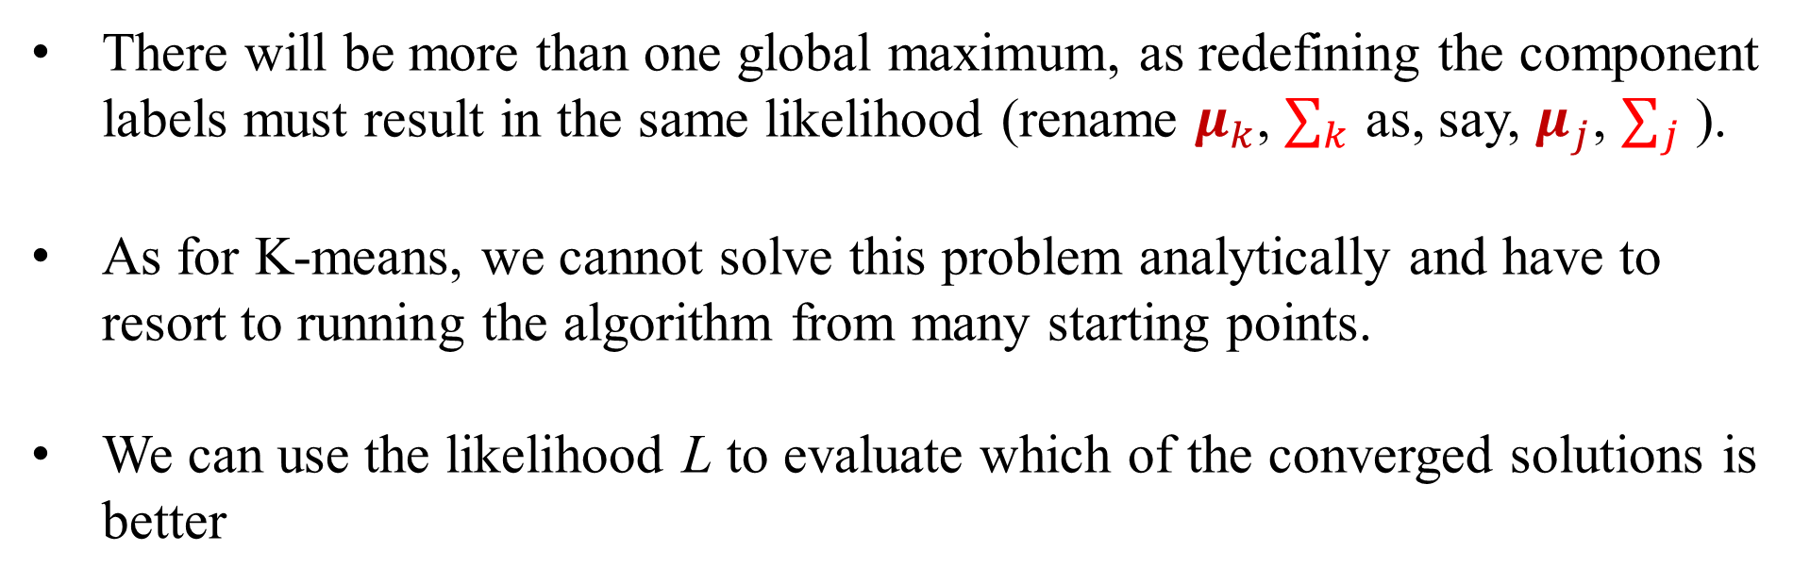
EM Finds Local Optima
There will be more than one global maximum, as redefining the component labels must result in the same likelihood (rename $μ_{k}$, $∑_{k}$ as, say, $μ_{j}$, $∑_{j}$ ).
As for K-means, we cannot solve this problem analytically and have to resort to running the algorithm from many starting points.
We can use the likelihood L to evaluate which of the converged solutions is better

Slide 29
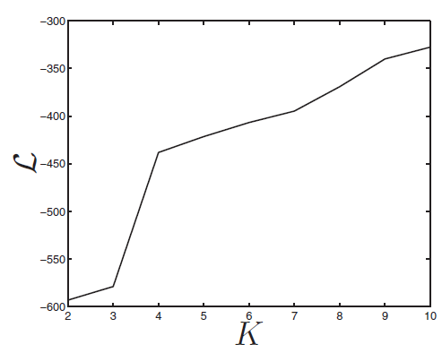
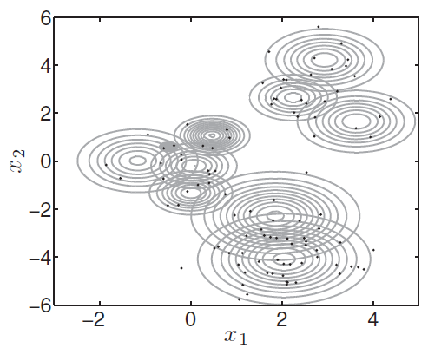
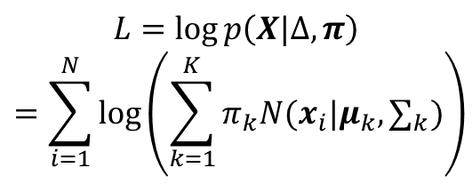
Choosing the Number of Components
K = 10
$$L=\log{p\left(X|∆, π\right)}$$
$$=\sum_{i=1}^{N}{\log\left(\sum_{k=1}^{K}{π_{k}N(x_{i}|μ_{k},∑_{k})}\right)}$$
Because the volume of 3D Gaussian =1, the smaller area they occupy in the input space the higher they must be.
Sum of the log of the heights for the log-likelihood, L, will be higher as we add more and more components, the area they need to take up decreases and the likelihood increases further.

Slide 30
MATLAB script: gmixcv.m
%% gmixcv.m % From A First Course in Machine Learning, Chapter 6.
% CV for selection of K in a Gaussian Mixture
clear all;close all;
load ../data/kmeansdata/X.csv %% Load the data
%% Plot the data
figure(1);hold off
plot(X(:,1),X(:,2),'ko');
%% Do a 10-fold CV
NFold = 10; N = size(X,1);
sizes = repmat(floor(N/NFold),1,NFold);
sizes(end) = sizes(end) + N - sum(sizes);
csizes = [0 cumsum(sizes)];
order = randperm(N); % Randomize the data order
MaxIts = 100;
%% Loop over K
Kvals = 1:10;
for kv = 1:length(Kvals)
K = Kvals(kv);
for fold = 1:NFold
fprintf('\nK: %g, fold: %g',K,fold);
foldindex = order(csizes(fold)+1:csizes(fold+1));
trainX = X; trainX(foldindex,:) = [];
testX = X(foldindex,:);

Slide 31
% Train the mixture
means = randn(K,2);
for k = 1:K
covs(:,:,k) = rand*eye(2);
end
priors = repmat(1/K,1,K); B = []; B(1) = -inf;
converged = 0; it = 0; tol = 1e-2; Ntrain = size(trainX,1);D = size(X,2);
while 1
it = it + 1; temp = zeros(Ntrain,K);
for k = 1:K % Update q
const = -(D/2)*log(2*pi) - 0.5*log(det(covs(:,:,k)));
Xm = trainX - repmat(means(k,:),Ntrain,1);
temp(:,k) = const - 0.5 * diag(Xm*inv(covs(:,:,k))*Xm');
end
% Compute the Bound on the likelihood
if it>1
B(it) = sum(sum(q.*log(repmat(priors,Ntrain,1)))) + ...
sum(sum(q.*temp)) - sum(sum(q.*log(q)));
if abs(B(it)-B(it-1))<tol
converged = 1;
end
end
if converged == 1 || it> MaxIts
break
end

Slide 32
temp = temp + repmat(priors,Ntrain,1);
q = exp(temp - repmat(max(temp,[],2),1,K));
% Minor hack for numerical issues - stops the code crashing when
% clusters are empty - would be better to use MAP.
q(q<1e-3) = 1e-3; q(q>1-1e-3) = 1-1e-3; q = q./repmat(sum(q,2),1,K);
priors = mean(q,1); % Update priors
for k = 1:K % Update means
means(k,:) = sum(trainX.*repmat(q(:,k),1,D),1)./sum(q(:,k));
end
for k = 1:K % update covariances
Xm = trainX - repmat(means(k,:),Ntrain,1);
covs(:,:,k) = (Xm.*repmat(q(:,k),1,D))'*Xm;
covs(:,:,k) = covs(:,:,k)./sum(q(:,k));
end
end
Ntest = size(testX,1); temp = zeros(Ntest,K);
for k = 1:K % Compute the held-out likelihood
const = -(D/2)*log(2*pi) - 0.5*log(det(covs(:,:,k)));
Xm = testX - repmat(means(k,:),Ntest,1);
temp(:,k) = const - 0.5 * diag(Xm*inv(covs(:,:,k))*Xm');
end
temp = exp(temp).*repmat(priors,Ntest,1);
outlike(kv,csizes(fold)+1:csizes(fold+1)) = log(sum(temp,2))';
end
end
errorbar(Kvals,mean(outlike,2),std(outlike,1,2)./sqrt(N)); %% Plot the evolution in log likelihood
xlabel('K'); ylabel('Average held-out likelidood (+- standard error)');

Slide 33

Result of MATLAB script: gmixcv.m
The results are not conclusive but they do give us an indication that the likely number lies somewhere between, say, 3 and 8.

Slide 34

The ability to cluster different perfusion compartments in the brain is critical for analyzing brain perfusion. This study presents a method based on a mixture of multivariate Gaussians (MoMG) and the expectation-maximization (EM) algorithm to dissect various perfusion compartments from dynamic susceptibility contrast (DSC) MR images so that each compartment comprises pixels of similar signal-time curves. This EM-based method provides an objective way to 1) delineate an area to serve as the in-plane arterial input function (AIF) of the feeding artery for adjacent tissues to better quantify the relative cerebral blood volume (rCBV), relative cerebral blood flow (rCBF), and mean transit time (MTT); 2) demarcate regions with abnormal perfusion derangement to facilitate diagnosis; and 3) obtain parametric maps with supplementary information, such as temporal scenarios and recirculation of contrast agent. Results from normal subjects show that perfusion cascade manifests (in order of appearance) the arteries, gray matter (GM), white matter (WM), veins and sinuses, and choroid plexus mixed with cerebrospinal fluid (CSF). The averaged rCBV, rCBF, and MTT ratios between GM and WM are in good agreement with those in the literature. Results from a patient with cerebral arteriovenous malformation (CAVM) showed distinct spatiotemporal characteristics between perfusion patterns, which allowed differentiation between pathological and nonpathological areas.

Slide 35

Example

Slide 36






Mixture of Gaussian
Initial parameter
$$θ_{int}\left(μ_{l},Σ_{l}\right) l=1,2,3…L$$
$$p(x\left|θ\right.)=\sum_{l=1}^{L}{p(z=l)p(x\left|z=l\right.)} \\ =\sum_{l=1}^{L}{π_{l}G_{x}[μ_{l},∑_{l}]}$$
Parameters estimation by EM
E-step: calculate the posterior density
M-step: maximize and update
$$p(l\left|x_{i}\right.,θ_{t−1})=\frac{G_{x_{i}}[μ_{l}^{t−1},Σ_{l}^{t−1}]π_{l}^{t−1}}{\sum_{l=1}^{L}{G_{x_{i}}[μ_{l}^{t−1},Σ_{l}^{t−1}]π_{l}^{t−1}}}$$
mathematically simple
no spatial information
$$μ_{l}^{new}=\frac{\sum_{i=1}^{N}{p(l\left|x_{i},θ_{t−1}\right.)x_{i}}}{\sum_{i=1}^{N}{p(l\left|x_{i},θ_{t−1}\right.)}}$$
$$Σ_{l}^{new}=\frac{\sum_{i=1}^{N}{p(l\left|x_{i},θ_{t−1}\right.)x_{i}x_{i}^{T}}}{\sum_{i=1}^{N}{p(l\left|x_{i},θ_{t−1}\right.)}}−μ_{l}^{new}(μ_{l}^{new})^{T}$$
$$π_{l}^{new}=\frac{1}{N}\sum_{i=1}^{N}{p(l\left|x_{i},θ_{t−1}\right.)}$$
Converge
Done

Slide 37







Example: Segmentation Result

Slide 38


Example: Segmentation Result
time (second)

Slide 39


Slide 40


A Mixture Model for Binary Data
Each data object $x_{n}$ is a collection of D binary values, e.g., D = 10, an example data object might be $x_{n}=\left[0 1 0 1 1 1 0 0 0 1\right]$
An example binary dataset with N = 100 objects and D = 10 dimensions. Each row represents one data object.
Assume the dimensions are independent
within a particular component,
$p\left(x_{n} | p_{k}\right)=\prod_{d=1}^{D}{p_{kd}^{x_{nd}}}{\left(1−p_{kd}\right)}^{1−x_{nd}}$
where $p_{k}={\left[p_{k1},⋯,p_{kD}\right]}^{T}$ is a vector of
D-dim probabilities for the kth component

Slide 41

EM Algorithm for Mixture of Product of Bernoulli Distributions
$$B=\sum_{n=1}^{N}{E_{q_{nk}}\left\{\log{\frac{π_{k}p(x_{n}|p_{k})}{q_{nk}}}\right\}}=\sum_{n=1}^{N}{\sum_{k=1}^{K}{q_{nk}\log{\frac{π_{k}p(x_{n}|p_{k})}{q_{nk}}}}}=\sum_{n=1}^{N}{\sum_{k=1}^{K}{q_{nk}\log{π_{k}}}}+\sum_{n=1}^{N}{\sum_{k=1}^{K}{q_{nk}\log{p(x_{n}|p_{k})}}−}\sum_{n=1}^{N}{\sum_{k=1}^{K}{q_{nk}\log{q_{nk}}}}$$
Value of $q_{nk},π_{k},p_{k}$ that correspond to a local maxima of this bound will also correspond to a local maxima of the log-likelihood, $L$.
$\frac{∂B}{∂π_{k}}=0$ ⇒ $π_{k}=?$, $\frac{∂B}{∂p_{k}}=0$ ⇒ $p_{k}=?$, $\frac{∂B}{∂q_{nk}}=0$ ⇒ $q_{nk}=?$

Slide 42

Updating $π_{k}$
$$B=\sum_{n=1}^{N}{\sum_{k=1}^{K}{q_{nk}\log{π_{k}}}}+\sum_{n=1}^{N}{\sum_{k=1}^{K}{q_{nk}\log{p(x_{n}|p_{k})}}−}\sum_{n=1}^{N}{\sum_{k=1}^{K}{q_{nk}\log{q_{nk}}}},\sum_{k=1}^{K}{π_{k}}=1$$
This is a constrained optimization, we use Lagrange multiplier $λ$ such that
$$B=\sum_{n=1}^{N}{\sum_{k=1}^{K}{q_{nk}\log{π_{k}}}}−λ\left(\sum_{k=1}^{K}{π_{k}}−1 \right)+⋯$$
$\frac{∂B}{∂π_{k}}=0$ ⇒ $\sum_{n=1}^{N}{q_{nk}}\frac{1}{π_{k}}−λ=0$
⇒ $\sum_{n=1}^{N}{q_{nk}}=λπ_{k}$
⇒ $\sum_{k=1}^{K}{\sum_{n=1}^{N}{q_{nk}}}=λ\sum_{k=1}^{K}{π_{k}}$
⇒ $\sum_{n=1}^{N}{1}=λ$, since $\sum_{k=1}^{K}{q_{nk}}=1$
⇒ $N=λ$
⇒ $π_{k}=\frac{1}{N}\sum_{n=1}^{N}{q_{nk}}$

Slide 43


Updating $p_{k}$
$$B∝\sum_{n=1}^{N}{\sum_{k=1}^{K}{q_{nk}\log{p\left(x_{n} | p_{k}\right)}}}=\sum_{n=1}^{N}{\sum_{k=1}^{K}{q_{nk}\log{\prod_{d=1}^{D}{p_{kd}^{x_{nd}}}{\left(1−p_{kd}\right)}^{1−x_{nd}}}}}=\sum_{n=1}^{N}{\sum_{k=1}^{K}{q_{nk}\sum_{d=1}^{D}{\left(x_{nd}\log{p_{kd}}+\left(1−x_{nd}\right)\log\left(1−p_{kd}\right)\right)}}}$$
$$\frac{∂B}{∂p_{kd}}=\sum_{n=1}^{N}{q_{nk}}\left(x_{nd}×\frac{1}{p_{kd}}+\left(1−x_{nd}\right)×\frac{−1}{1−p_{kd}}\right)=\sum_{n=1}^{N}{q_{nk}}\left(\frac{x_{nd}\left(1−p_{kd}\right)−p_{kd}\left(1−x_{nd}\right)}{p_{kd}(1−p_{kd})}\right)=\sum_{n=1}^{N}{q_{nk}}\left(\frac{x_{nd}−p_{kd}}{p_{kd}(1−p_{kd})}\right)=0$$
$⇒p_{kd}=\frac{\sum_{n=1}^{N}{q_{nk}}x_{nd}}{\sum_{n=1}^{N}{q_{nk}}}$

Slide 44

Updating $q_{nk}$
$$B=\sum_{n=1}^{N}{\sum_{k=1}^{K}{q_{nk}\log{π_{k}}}}+\sum_{n=1}^{N}{\sum_{k=1}^{K}{q_{nk}\log{p\left(x_{n} | p_{k}\right)}}−}\sum_{n=1}^{N}{\sum_{k=1}^{K}{q_{nk}\log{q_{nk}}}},\sum_{k=1}^{K}{q_{nk}}=1$$
This is a constrained optimization, we use Lagrange multiplier $λ$ such that
$$B=\sum_{n=1}^{N}{\sum_{k=1}^{K}{q_{nk}\log{π_{k}}}}+\sum_{n=1}^{N}{\sum_{k=1}^{K}{q_{nk}\log{p\left(x_{n} | p_{k}\right)}}−}\sum_{n=1}^{N}{\sum_{k=1}^{K}{q_{nk}\log{q_{nk}}}}−λ\left(\sum_{k=1}^{K}{q_{nk}}−1\right)$$
$\frac{∂B}{∂q_{nk}}=\log{π_{k}}+\log{p\left(x_{n} | p_{k}\right)}−1×\log{q_{nk}}−q_{nk}×\frac{1}{q_{nk}}−λ=0$
⇒ $1+λ+\log{q_{nk}}=\log\left(π_{k}p\left(x_{n} | p_{k}\right)\right)$ ⇒ $e^{1+λ+\log{q_{nk}}}=e^{1+λ}q_{nk}=π_{k}p\left(x_{n} | p_{k}\right)$
⇒ $e^{1+λ}\sum_{k=1}^{K}{q_{nk}}=e^{1+λ}×1=\sum_{k=1}^{K}{π_{k}p\left(x_{n} | p_{k}\right)}$
⇒ $q_{nk}=\frac{π_{k}p\left(x_{n} | p_{k}\right)}{e^{1+λ}}=\frac{π_{k}p\left(x_{n} | p_{k}\right)}{\sum_{j=1}^{K}{π_{j}p\left(x_{n} | p_{k}\right)}}$

Slide 45

EM Algorithm for Mixture of Product of Bernoulli Distributions
Initialize the probabaility $p_{k}$ and mixing coefficients $π_{k}$
Iterate until convergence:
E-step: Evaluate the assignment probabilities given current parameters
$$q_{nk}=p(z_{nk}=1, |x_{n},∆, π)=\frac{π_{k}p\left(x_{n} | p_{k}\right)}{\sum_{j=1}^{K}{π_{j}p\left(x_{n} | p_{j}\right)}}=\frac{p(z_{nk}=1)p\left(x_{n} | p_{k}\right)}{\sum_{j=1}^{K}{p(z_{nj}=1)p\left(x_{n} | p_{j}\right)}}$$
M-step: Re-estimate the parameters given current $q_{nk}$
$$N_{k}≡\sum_{n=1}^{N}{q_{nk}}, p_{kd}=\frac{\sum_{n=1}^{N}{q_{nk}}x_{nd}}{\sum_{n=1}^{N}{q_{nk}}}=\frac{\sum_{n=1}^{N}{q_{nk}}x_{nd}}{N_{k}}, π_{k}=\frac{N_{k}}{N}$$
Evaluate log likelihood and check for convergence
$$\log{p\left(X|∆, π\right)}=\log{\prod_{n=1}^{N}{p(x_{n}|∆, π)}}=\sum_{n=1}^{N}{\log\left(\sum_{k=1}^{K}{p\left(z_{nk} | π\right)p(x_{n}|z_{nk};p_{k})}\right)}=\sum_{n=1}^{N}{\log\left(\sum_{k=1}^{K}{π_{k}\prod_{d=1}^{D}{p_{kd}^{x_{nd}}}{\left(1−p_{kd}\right)}^{1−x_{nd}}}\right)}$$

Slide 46

Example for Mixture Model with binary components
K = 5 clusters extracted from the data in left plot using the mixture model with binary components.

Slide 47
MATLAB script: binmix.m
%% binmix.m % From A First Course in Machine Learning, Chapter 6.
% Mixture model for binary data
clear all;close all;
%% Generate the data
K = 5; priors = repmat(1/K,1,K); D = 10; %Number of dimensions
probs = rand(K,D); % The binary probabilities
N = 100; % The number of data objects
t = [];
for n = 1:N
% Which component?
pos = find(rand<cumsum(priors));
t(n,1) = pos(1);
for d = 1:D
X(n,d) = (rand<probs(t(n,1),d));
end
end
% Sort the data for visualisation
[t I] = sort(t);
X = X(I,:);
%% Image the data
figure(1);hold off imagesc(X);

Slide 48
%% Run the mixture
K = 5; % Try changing this
B = []; B(1) = -inf; pkd = rand(K,D); pri = repmat(1/K,1,K); converged = 0;
it = 0; tol = 1e-2; MaxIts = 100;
alpha = 2;beta = 2; % MAP Smoothing parameters - set to 1 to turn off smoothing (may cause numerical instability)
while 1
it = it + 1;
temp = zeros(N,K); % Update q
for k = 1:K
temp(:,k) = sum(X.*log(repmat(pkd(k,:),N,1))+(1-X).*log(repmat(1-pkd(k,:),N,1)),2);
end
temp = temp + repmat(log(pri),N,1);
% Compute B
if it>1
B(it) = sum(sum(q.*log(repmat(priors,N,1))))+sum(sum(q.*temp))-sum(sum(q.*log(q)));
% Prior contributions (due to smoothing)
B(it) = B(it) + K*D*gammaln(alpha+beta) - K*D*gammaln(alpha) - K*D*gammaln(beta);
B(it) + B(it) + (alpha-1)*sum(sum(log(pkd))) + (beta - 1)*sum(sum(log(1-pkd)));
if abs(B(it)-B(it-1))<tol
converged = 1;
end
end
if converged == 1 || it>MaxIts
break
end

Slide 49
q = exp(temp - repmat(max(temp,[],2),1,K));
q = q./repmat(sum(q,2),1,K);
% Update priors
pri = mean(q,1);
% Update probabilites
for k = 1:K
pkd(k,:) = (alpha - 1 + sum(repmat(q(:,k),1,D).*X,1))./(alpha +beta-2+sum(q(:,k)));
end
end
%% Plot the bound
figure(2); hold off
plot(B);xlabel('Iterations');ylabel('Bound');
%% Visualise the clusters
assi = (q==repmat(max(q,[],2),1,K));
for k = 1:K
figure(k);hold off
imagesc(X(assi(:,k),:));ti = sprintf('Cluster: %g',k); title(ti);
end
%% Image the q values
% Note that because the data are in order, we should see clear block
% structure. It won't be perfect: our clusters were randomly generated so
% there is no gaurantee that they are particularly different.
figure(6);hold off
imagesc(q); xlabel('Cluster'); ylabel('Object');
figure(7);hold off
imagesc(assi); xlabel('Cluster'); ylabel('Object');

Slide 50






the binary data
$q_{nk}=$
$\frac{p(z_{nk}=1)p\left(x_{n} | p_{k}\right)}{\sum_{j=1}^{K}{p(z_{nj}=1)p\left(x_{n} | p_{j}\right)}}$
Cluster=
$$arg\max_{k}{q_{nk}}$$

Slide 51






Slide 52

MAP Estimates with EM
If we have a limited quantity of data, it is useful to regularize the parameter estimates obtained via EM.
We can multiply the likelihood by suitable prior densities for the parameters and obtain the MAP estimate
In the binary example, we may use beta prior $p(r)=\frac{Γ(α+β) }{Γ(α)Γ(β)}r^{α−1}{(1−r)}^{β−1}$ and assume the independence for each $p_{kd}$ and have
$$p\left(p_{1},⋯,p_{K} | α,β\right)=\prod_{k=1}^{K}{\prod_{d=1}^{D}{\frac{Γ(α+β) }{Γ(α)Γ(β)}{p_{kd}}^{α−1}{(1−p_{kd})}^{β−1}}}$$
Recall the likelihood for $x_{n}$ is
$$p\left(x_{n} | p_{k}\right)=\prod_{d=1}^{D}{p_{kd}^{x_{nd}}}{\left(1−p_{kd}\right)}^{1−x_{nd}}$$

Slide 53

For MAP, We Multiple Likelihood by the Prior
We require the likelihood of $x_{n}$ under the whole model: $p\left(x_{n}|∆, π\right)$
Start with the likelihood of a particular data object conditioned on $z_{nk}=1$
$$p\left(x_{n}|z_{nk}=1,∆\right)=p\left(x_{n}|∆_{k}\right)$$
⇒ $p\left(x_{n}|z_{nk}=1,∆\right)p(z_{nk}=1)=p\left(x_{n}|∆_{k}\right)$ $p(z_{nk}=1)$
⇒ $p\left(x_{n},z_{nk}=1|∆, π\right)=p\left(x_{n}|∆_{k}\right)π_{k}$
⇒ $\sum_{k=1}^{K}{p\left(x_{n},z_{nk}=1|∆, π\right)}=\sum_{k=1}^{K}{π_{k}p\left(x_{n}|∆_{k}\right)}$
⇒
$$p\left(x_{n}|∆, π\right)=\sum_{k=1}^{K}{π_{k}p(x|p_{k})} where p_{k} is binormial$$
Assume $x_{1}, ⋯,x_{n}$ are conditionally independent, for MAP we maximize
$$p\left(X|∆, π\right)p\left(p_{1},⋯,p_{K} | α,β\right)=\prod_{n=1}^{N}{\left(\sum_{k=1}^{K}{π_{k}p\left(x_{n}|∆_{k}\right)}\right)}\left(\prod_{k=1}^{K}{\prod_{d=1}^{D}{\frac{Γ(α+β) }{Γ(α)Γ(β)}{p_{kd}}^{α−1}{(1−p_{kd})}^{β−1}}}\right)$$

Slide 54


Lower Bound of likelihood $×$ prior
To use Jensen's inequality to lower bound our likelihood $×$ prior, we need to make the right hand side look like the log of an expectation.
$$L=\sum_{n=1}^{N}{\log{\sum_{k=1}^{K}{π_{k}p(x_{n}|p_{k})}}}\frac{q_{nk}}{q_{nk}}+\log{\prod_{k=1}^{K}{\prod_{d=1}^{D}{\frac{Γ(α+β) }{Γ(α)Γ(β)}{p_{kd}}^{α−1}{(1−p_{kd})}^{β−1}}}}$$
$$=\sum_{n=1}^{N}{\log{\sum_{k=1}^{K}{q_{nk}}}}\frac{π_{k}p(x_{n}|p_{k})}{q_{nk}}+\log{\prod_{k=1}^{K}{\prod_{d=1}^{D}{\frac{Γ(α+β) }{Γ(α)Γ(β)}{p_{kd}}^{α−1}{(1−p_{kd})}^{β−1}}}}$$
$$=\sum_{n=1}^{N}{\log{E_{q_{nk}}\left\{\frac{π_{k}p(x_{n}|p_{k})}{q_{nk}}\right\}}}+\log{\prod_{k=1}^{K}{\prod_{d=1}^{D}{\frac{Γ(α+β) }{Γ(α)Γ(β)}{p_{kd}}^{α−1}{(1−p_{kd})}^{β−1}}}}$$
$$≥\sum_{n=1}^{N}{E_{q_{nk}}\left\{\log{\frac{π_{k}p(x_{n}|p_{k})}{q_{nk}}}\right\}}+\log{\prod_{k=1}^{K}{\prod_{d=1}^{D}{\frac{Γ(α+β) }{Γ(α)Γ(β)}{p_{kd}}^{α−1}{(1−p_{kd})}^{β−1}}}}≡B$$
where $q_{nk}$ is some probability distribution over the $K$ components for $x_{n}$

Slide 55


Updating $p_{k}$ using MAP
$$B=\sum_{n=1}^{N}{E_{q_{nk}}\left\{\log{\frac{π_{k}p(x_{n}|p_{k}) }{q_{nk}}}\right\}}+\log{\prod_{k=1}^{K}{\prod_{d=1}^{D}{\frac{Γ(α+β) }{Γ(α)Γ(β)}{p_{kd}}^{α−1}{(1−p_{kd})}^{β−1}}}}∝\sum_{n=1}^{N}{\sum_{k=1}^{K}{q_{nk}\log{p\left(x_{n} | p_{k}\right)}}}+\sum_{k=1}^{K}{\sum_{d=1}^{D}{\left(\left(α−1\right)\log{p_{kd}}+\left(β−1\right)\left(1−p_{kd}\right)\right)}}∝\sum_{n=1}^{N}{\sum_{k=1}^{K}{q_{nk}\log{\prod_{d=1}^{D}{p_{kd}^{x_{nd}}}{\left(1−p_{kd}\right)}^{1−x_{nd}}}}}+\sum_{k=1}^{K}{\sum_{d=1}^{D}{\left(\left(α−1\right)\log{p_{kd}}+\left(β−1\right)\left(1−p_{kd}\right)\right)}}=\sum_{n=1}^{N}{\sum_{k=1}^{K}{q_{nk}\sum_{d=1}^{D}{\left(x_{nd}log{p_{kd}}+\left(1−x_{nd}\right)\log\left(1−p_{kd}\right)\right)}}}+\sum_{k=1}^{K}{\sum_{d=1}^{D}{\left(\left(α−1\right)\log{p_{kd}}+\left(β−1\right)\left(1−p_{kd}\right)\right)}}$$
$\frac{∂B}{∂p_{kd}}=\left\{\sum_{n=1}^{N}{q_{nk}}\left(\frac{x_{nd}}{p_{kd}}−\frac{\left(1−x_{nd}\right)}{1−p_{kd}}\right)\right\}+\left\{\frac{\left(α−1\right)}{p_{kd}}−\frac{\left(β−1\right)}{1−p_{kd}}\right\}=\left\{\sum_{n=1}^{N}{q_{nk}}\left(\frac{x_{nd}−p_{kd}}{p_{kd}(1−p_{kd})}\right)\right\}+\left\{\frac{\left(α−1\right)−p_{kd}(α+β−2)}{p_{kd}(1−p_{kd})}\right\}=0$
$⇒p_{kd}=\frac{α−1+\sum_{n=1}^{N}{q_{nk}}x_{nd}}{α+β−2+\sum_{n=1}^{N}{q_{nk}}}$

Slide 56

Regularizing Effect of Adding Prior
If $α=β=1$, $p_{kd}=\frac{α−1+\sum_{n=1}^{N}{q_{nk}}x_{nd}}{α+β−2+\sum_{n=1}^{N}{q_{nk}}}=\frac{\sum_{n=1}^{N}{q_{nk}}x_{nd}}{\sum_{n=1}^{N}{q_{nk}}}$ ⇒ no prior
Without prior, if $x_{nd}=1$(or $=0$ ) $∀n$ ⇒ $p_{kd}=\frac{\sum_{n=1}^{N}{q_{nk}}x_{nd}}{\sum_{n=1}^{N}{q_{nk}}}=1$ (or $=0$ )
⇒ likelihood $p\left(x_{n} | p_{k}\right)=\prod_{d=1}^{D}{p_{kd}^{x_{nd}}}{\left(1−p_{kd}\right)}^{1−x_{nd}}=0$ $∀n$
⇒ If a new data object did not have $x_{nd}$ $=1$(or $=0$ ) , it would have a
likelihood of zero of belonging to this cluster regardless of its values in
the other $D−1$ dimensions.
With prior, $\frac{α−1}{α+β−2}≤p_{kd}=\frac{α−1+\sum_{n=1}^{N}{q_{nk}}x_{nd}}{α+β−2+\sum_{n=1}^{N}{q_{nk}}}≤\frac{α−1+N}{α+β−2+N}$, i.e., $p_{kd}$ will not be 1 or 0 ⇒ regularizing effect

Slide 57

Summary: EM versus K-Means
The K-Means Algorithm:
1. Assignment step: Assign each data point to the closest cluster
2. Refitting step: Move each cluster center to the center of gravity of the
data assigned to it
The EM Algorithm:
1. E-step: Compute the posterior probability over $z_{nk}$ given our current model
2. M-step: Maximize the probability that it would generate the data it is currently responsible for.
The K-means algorithm and the EM algorithm for mixture models are both only guaranteed to reach local optima.
The particular solution that is reached depends on the initialization

Slide 58
Summary: Mixture of Gaussians versus K-means
EM for mixtures of Gaussians is just like a soft version of K-means, with fixed priors and covariance
Instead of hard assignments in the E-step, we do soft assignments based on the softmax of the squared Mahalanobis distance from each point to each cluster.
Each center moved by weighted means of the data, with weights given by soft assignments
In K-means, weights are 0 or 1

Slide 59
Homework #11
Modify the code Lecture 11 EM_oop.jpynb to implement the clustering of two-dimensional datasets in Lecture 05_1 kmeans_oop.jpynb.
Hint: see Homework 11_todo.jpynb
Deadline of Homework #11: 2022/12/19 3:30pm

